Slide 1

Outdoor
Learning and Play
An inclusive approach
Psychological Service Home Visiting Teachers
Notes:
8 teachers across Highland.
Support children with additional support needs from 0-3 at home and with their transition into ELCs
Support for settings from EPs and PSHVTS – consultation and training
We link our work with ELCs and our support of children to Realising The Ambition, looking at:
Spaces
Experiences
Interactions
Todays focus is on inclusion in outdoor learning for children with ASN

Slide 2
Challenges
Getting around
  Changes in terrain
  Boundaries
Weather
“Can I join in?”
Differentiation outdoors
Communication
Safety
Meet your challenges with personalised solutions
Notes:
Getting around
Changes in terrain:
different levels, rough ground, hills and slopes = Mobility issues, wheels may not cope, children with balance/coordination/visual issues can be unsteady on their feet
Visual Impairment – some children who may have difficulty seeing changes in terrain – pathways etc
Boundaries:
Physical – gates/ fences, Safety aspects for children with little awareness of common dangers
Children might not recognise ‘rules’ – ‘we can climb but not the boundary walls’, ‘don’t go through the gate’
You cant always choose your terrain or boundaries – you have to work with what you have.
Weather:
‘There is no such thing as bad weather just the wrong clothing’ but…
Challenges in the environment – thunder lightning sunburn heavy rain
Some children struggle with - too much weather, sensory overload,
Keeping warm – some children struggle to maintain their core body temperature – wheelchair/buggy users – how do you check?
Children with neurodevelopmental differences don’t always recognise when they are cold or uncomfortable
Wet ground impacts on wheels and can look and feel very different for children with VI/ND
Can I join in?
Can all the children move around all areas of the outdoor space? When they get there can they reach to play with the activities there?
Is the right equipment available outside?
Some equipment is for indoor use only – some for both; Standing frame indoors, Walking frame indoor and out, etc. Need to know.
Are the toys and tools matched to the children’s needs; right angled trowel for a child who cant manipulate wrist well, etc.
Differentiation Outdoors:
What’s different from indoors differentiation?
If a child needs a quiet, low arousal time inside, how do you provide that outside?
Communication:
Communication supports – how do I know what’s coming next? Are my communication supports inside/outside friendly
Knowing what happens in a space – if you have labels inside do you need to label outside? Objects of reference?
Safety:
This is not about general Risk assessment of your spaces. Its more about managing risks for individual children with ASN
How do we provide supported challenge – opportunities to risk take safely?
Are there any medical and therapeutic issues to take account of?

Slide 3
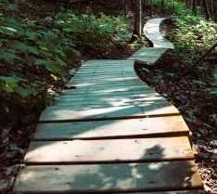
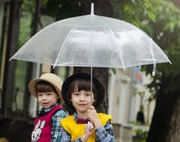
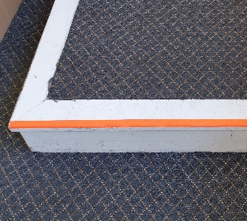
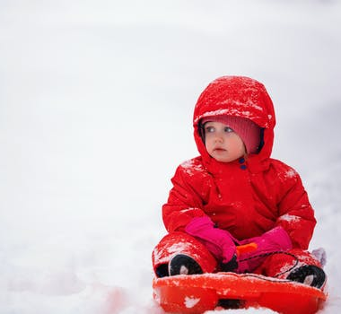
Spaces
Can I get there?
Portable pathways - easy access
Edge and boundary markers
Having some areas of flat ground
Moving between areas easily
What if the location of an experience is not accessible?
Too much weather!
V Borodinova on Pexels.com
Amanda Klamrowski on Pexels.com
Tetyana Kovyrina on Pexels.com
Notes:
Portable pathways for Easy Access
Portable pathways can help buggies, walking frames and wheelchairs cope with some variations in terrain and wet ground.
They can be moved where you need them.
Hi-Visibility edge markers
for children with VI - Changes in surface and levels may need to be marked and made clear e.g.
from playground to grass – may not be visible in poor weather
edge markers on steps
Boundaries:
Marking a boundary can create a visual ‘stop’ for children who may not understand ‘rules’.
Have some areas of flat ground
So not everywhere is a challenge
Portable mats can also be used to allow children to be on the ground for a different perspective – provide safe areas to lie or crawl
Moving between areas easily
Need sufficient space between areas, outdoor activities and furniture to allow easy movement for wheelchair users/buggies
What if the location of an experience is not accessible?
For ground-based activities, can everyone get on the ground or is there a way the activity can be brought to those that can’t.
All children need to access and feel wet, cold, mud, sand, leaves, etc. but this could need management
having a small amount of leaves on a mat or in a basket so its not a sensory overload
Manage in very small steps for children who have sensory aversions
Weather
Children need to experience weather but for some children ‘too much weather’ can be overwhelming/ overstimulating
Provide sheltered spaces to limit wind noise etc
See through umbrellas to experience rain without sensory impact
Some children may not recognise when they are cold
Children with mobility issues may need extra warmth/shelter

Slide 4
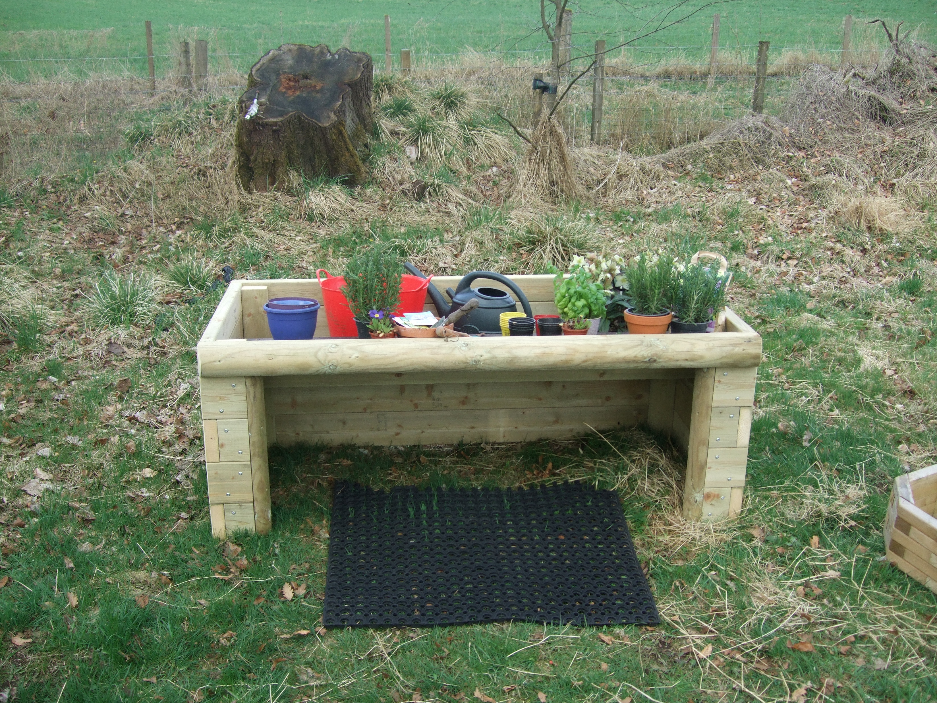
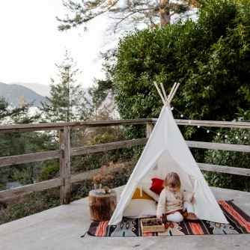
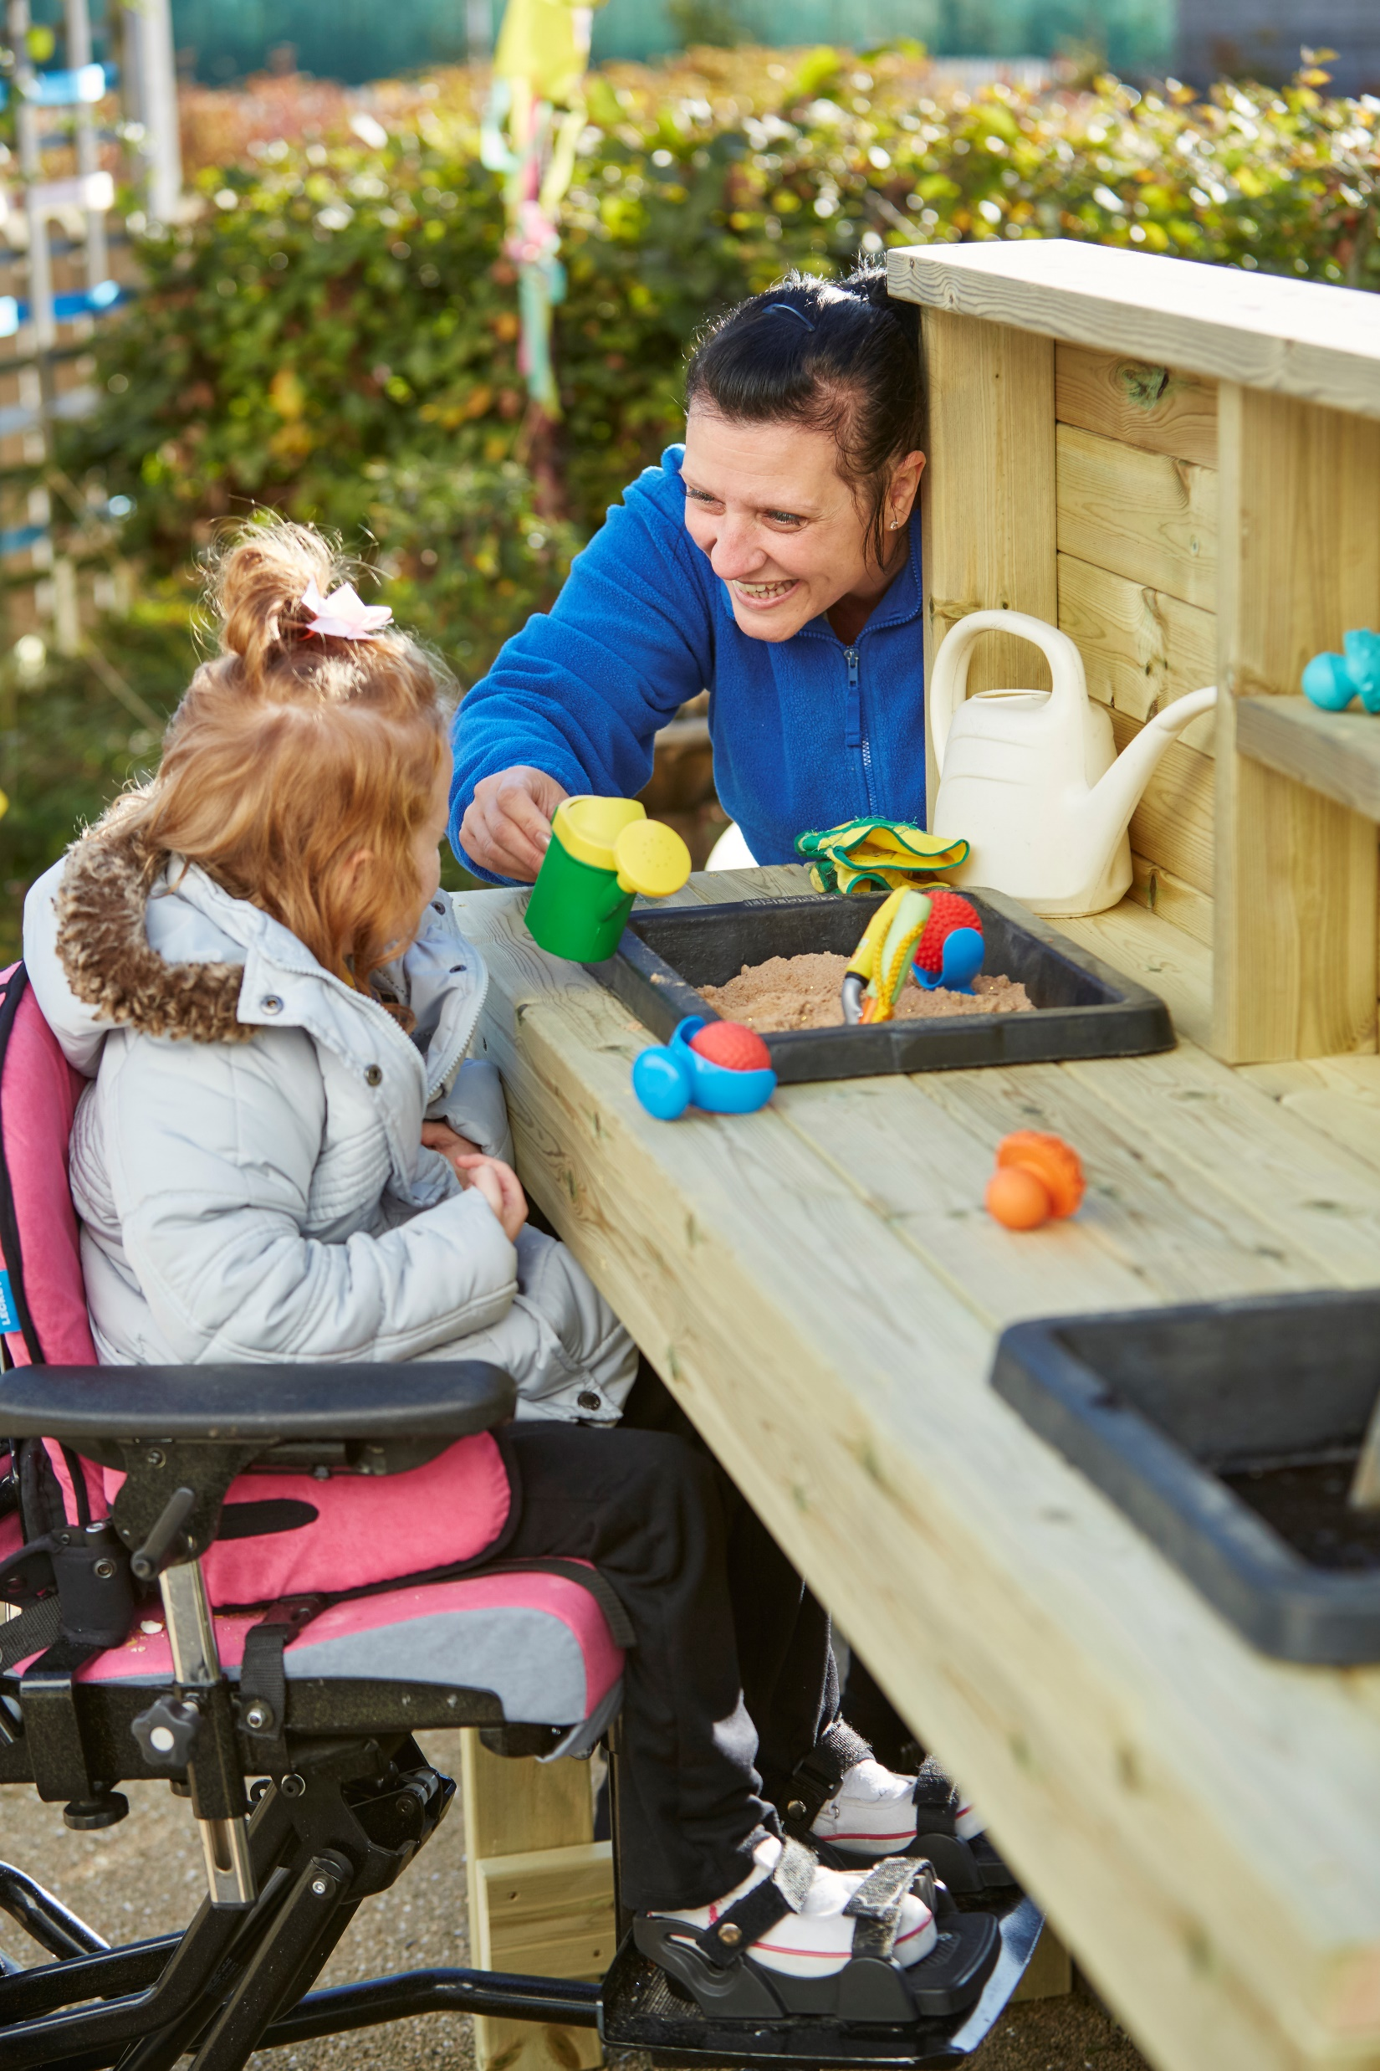
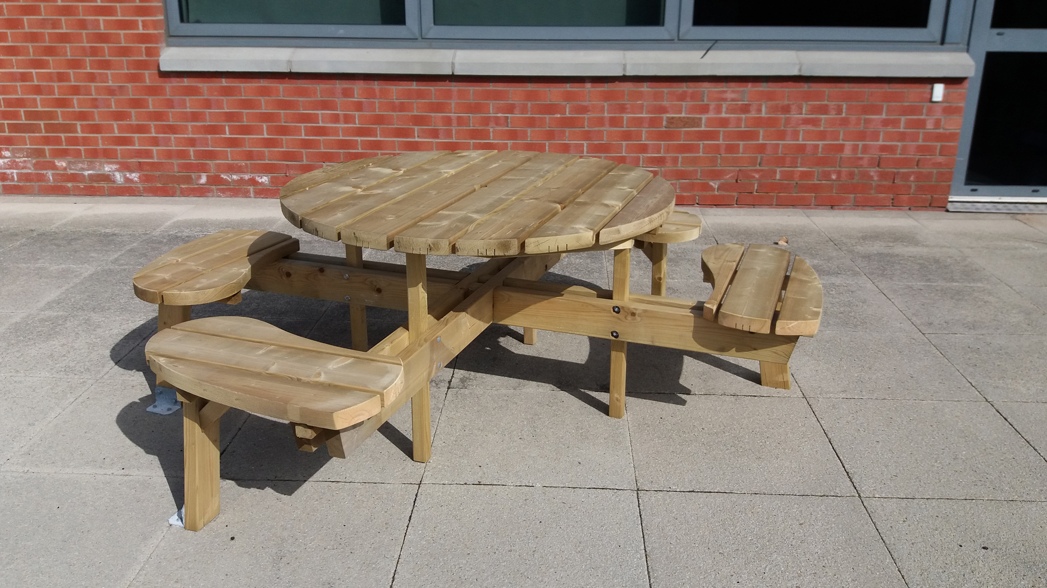
Experiences
Can I join in?
www.caledoniaplay.com
Does your outdoor furniture work for all the children?
Are activities physically accessible?
Is your furniture socially inclusive?
Are there special places?
Tatiana Syrikova on Pexels.com
www.caledoniaplay.com
www.spacekraft.co.uk
Notes:
Adaptations within spaces
This is about adaptations to equipment/furniture
Does your outdoor furniture work for all the children?
Can children get close enough to activities comfortably
Here are some examples of adapted furniture and resources - Height adjustable furniture etc
Are activities physically accessible?
These are just illustrations to support the principles – they can be done cheaply – a hammock/ sheet where you can manage the level of the experience instead of a swing. Provide the same experience in a different way.
NB: some children will need careful management of some experiences as they can be overwhelming and the effects can be long lasting. Some may not be suitable at all. For some children – consult with their parents and professionals involved to tailor to individual needs.
Is your furniture socially inclusive?
A picnic table with a space for a buggy/wheelchair
Can you adapt the furniture you already have?
Are there special places?
Not just about quiet areas/dens/hideouts for all children
How do you provide ‘low arousal spaces’ outside to meet individual needs – managing sensory/ social overload

Slide 5
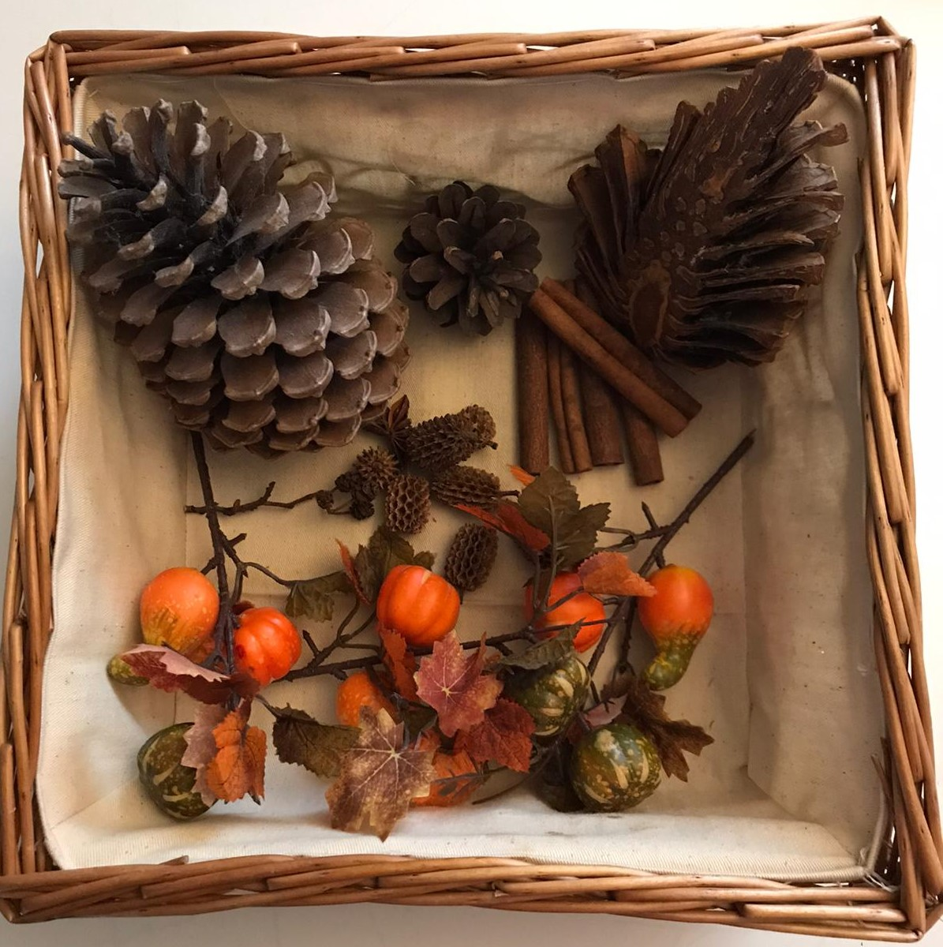
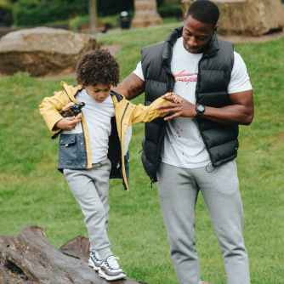

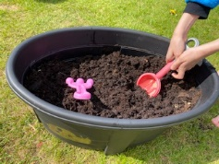
Experiences
Am I having fun?
Adapt or differentiate the activity
Role of the adult
Using a different tool/toy
Sensory considerations
Generalising skills
Anete Lusina on Pexels.com
Riccardo Lucon on Pexels.com
Notes:
Differentiation Outdoors - What’s different from indoors?
This is just a reminder that we need to adapt outdoor experiences as much as we do in indoors - to ensure inclusion
Adapt or differentiate the activity
and our expectations
Consider the task – small steps, what support is needed with some or all of it?
Do you need to bring some things to a child or use a different (quieter) space
Consider the role of the adult
knowing when to step in and step back
using support strategies - prompting, modelling, backward chaining, etc.
Using something different
adapted tools, Velcro gloves, etc.
Sensory considerations
Do you need to limit the sensory experience
do you need to add in sensory experiences
Generalising skills
Don’t assume generalisation - Be prepared to reteach a skill in the outdoor space that has already been mastered inside and vice versa.
Also - Are we hitting the spot? ‘Just because I am joining in doesn’t mean I am enjoying it.’
Passive children, limited communication, difficulty making choices, too much support? (Leuven scales)
Are they really participating?
Link to practical Play Ideas sheet

Slide 6
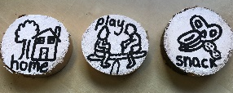
Interactions
Do I know what’s happening?
Supporting total communication
Consider the impact of elements outside
Can I play with my friends?
  Supporting social play interactions
Wood cookie visual timetable:
Stramash, Fort William
Notes:
Supporting adult and peer interactions
Adult
Supporting total communication
Supports need to be transferrable to support meaningful interactions - communication supports being used for an individual child need to work inside and out and away from the setting:
Now and next boards, choice boards, visual timetable, BIGmack, PECS,/Chat boards/PODD
Are they portable? Laminated symbols could become wood cookies
Are they waterproof? Electronic equipment in waterproof bags
Conditions can be different; rain/wind, may impact on a child receiving communication messages – they can be distracting or overwhelming – they may not hear or miss visual cues
Peer
Supporting social play interactions:
How do you support turn-taking outside? Do your inside strategies work outside (timers/visual symbols)
Making choices, Is everyone’s voice being heard?
How can you adapt activities to open up opportunities for peer interactions. - drainpipe between wheelchair/buggy user and peers for rolling cars etc

Slide 7
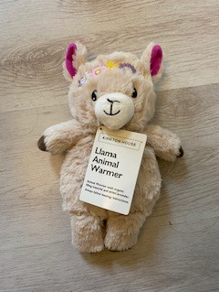
Am I safe?
Managing Risk and Providing Challenge
Medical Considerations
Personalise to your setting
Tailor to your children
Plan Ahead
Notes:
Managing Risk and Providing Challenge
How do we provide supported challenge – opportunities to risk take safely for all?
Children need to be exposed to challenges and experiences that may be difficult for them to get in other ways. Identify ways to provide supported challenge. A child can still experience the feeling of being in a swing but perhaps on a blanket or hammock, at a height where the child feels safe but excited. The feeling of speed or going downhill but managing the risk to children and staff, etc. Challenge = personal growth
Setting, sharing and managing boundaries/rules for children who have
limited awareness of common dangers (visual supports/social stories, etc.)
Communication needs
Consideration for developmental stage
Medical Considerations
Some risks are medical. You may need to consider:
portable protocols/emergency contacts/checking in more frequently
Storage and accessibility of medication
Maintaining core body temperature for children where this is an issue
Postural management and stretches
Responsibilities allocated to specific adults – and shared with everyone
Personalise to your setting and Tailored to your children PLAN AHEAD
Risk assessments which identify individual needs and steps to ensure safe approaches (mobility and sensory impairments)
Problem solve with the parents and professionals supporting the children.
To meet these challenges you need to personalise - to your children, settings and the community spaces you access.

Slide 8

EASEYS for ASN
Encourage And Support Early Years Skills for Additional Support Needs
Outdoor learning and play
Psychological Service Home Visiting Teachers
EASEYS for ASN and Play Ideas
https://highlandcouncilpsychologicalservice.wordpress.com/supporting-learners/
Notes:
Signpost to
EASEYS for ASN - Outdoor learning and play
https://highlandcouncilpsychologicalservice.wordpress.com/supporting-learners/easeys-for-asn/outdoor-learning-and-play/
Practical Ideas sheet
https://highlandcouncilpsychologicalservice.files.wordpress.com/2021/01/outdoor-learning-and-play-practical-ideas-jan-2021.pdf

