Slide 1

Supporting Mental Health
Thinking about our teenagers
Notes:
Teenagers are going through a challenging stage of development. They quite naturally prefer to spend time with their friends more so than their family. The current situation might be difficult for them.
The stage of development that they are at can impact on their mental health as their mental health can impact on their development. It is important to be aware of the development that is happening and how we can reach out and support young people at what can be a difficult time.
Relationships are key to supporting young people.
Please remember your own self care. It is important to remember that supporting young people can bring up things for ourselves. Identify people that will support you. Also remember that you might be working outwith your normal working environment so think about the processes for sharing information.

Slide 2
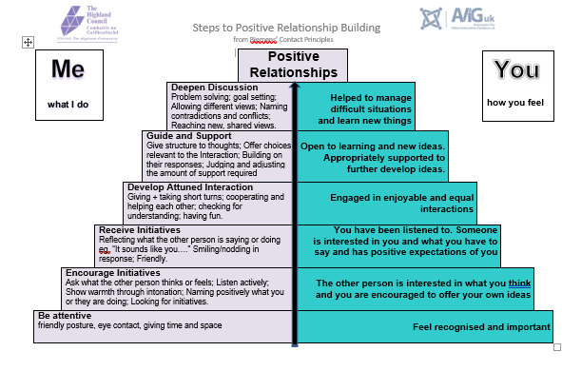
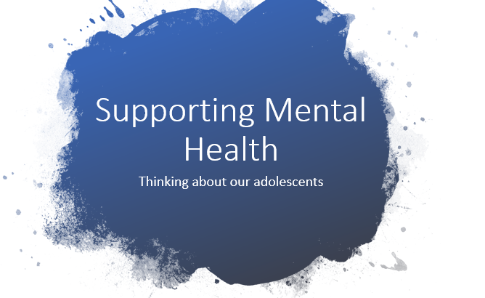
Notes:
It is important to remember that at the heart of all interactions is positive relationships. All of the information in the other training packages on nurture, positive relationships and emotional literacy, change, loss and bereavement are also key in thinking about how young people’s mental health and emotional wellbeing is supported.
This package helps us to develop this knowledge and think about how we support the mental health of our teenagers.
Please remember the pyramid tells us where we need to start when we think about building a relationship. If we don’t address the blocks at the base we can’t get to the place that we want to at the top of the pyramid where we problem solve and help young people to goal set.
Please remember we can still do all of this and still socially distance!

Slide 3
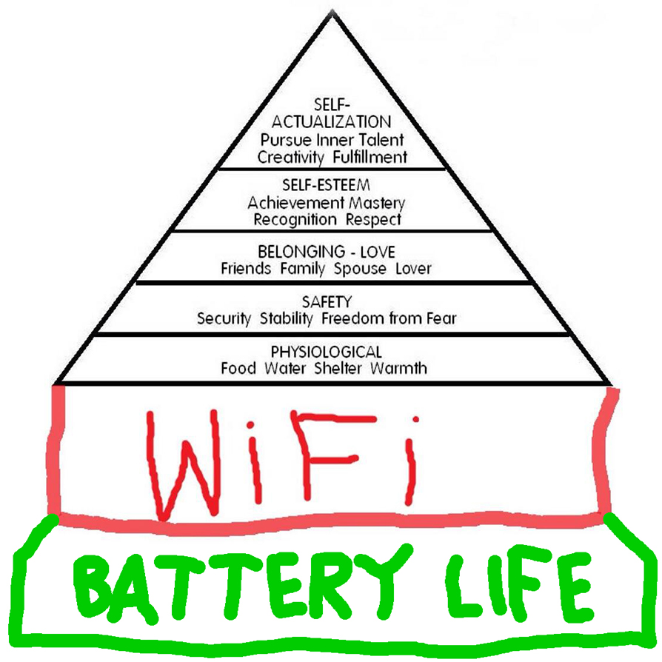
Maslow’s Hierarchy of needs – the teenage version ☺
Notes:
So we sometimes think quite comically about our teenagers. We can get frustrated about some of their ways. They aren’t choosing some of these ways but they are a response to the amount of development that is happening within their bodies. It is a necessary stage of development that they need to go through to become adults who are experienced and able to manage experiences and situations as well as being independent of the adults who have supported them to this stage. Think about yourselves and how your experiences as a teenager and how they helped you prepare for adulthood. You will remember the transitions that you made from being dependent on your parents/carers to being independent ….and the bits in between.
From the time that puberty starts teenagers are going through a huge amount of development. Their brain is going through a similar process as it did when they were aged 0-3 years old. They are also making sense of who they are and how they fit into the world. It is a time of change….lots of change.

Slide 4
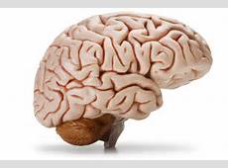
Teenage brain development
MRI scans – enabled us to see how teenage brains function differently to adults brains.
Teenagers may look physically mature but their brains are still developing.
Adults tend to use the front part (prefrontal cortex) to think, assess and plan.
Scans have shown us that the prefrontal cortex is underdeveloped in teenagers brains.
Teenagers use the limbic system (the emotional part of the brain) more than adults.
Notes:
So we know a lot more about brains now due to being able to use MRI scans to see what is happening in brains while they are still alive. Teenagers will look physically mature in many ways, however their brains are still going through a lot of development.
As adults, we have skills such as being able to think through situations, assess them and plan. This is because our prefrontal cortex is developed. We know from MRI scans that the prefrontal cortex is underdeveloped in teenage brains.
Teenagers use the limbic system (the emotional part of the brain) more then adults. This helps us to explain many of the reactions that we might be familiar with.

Slide 5
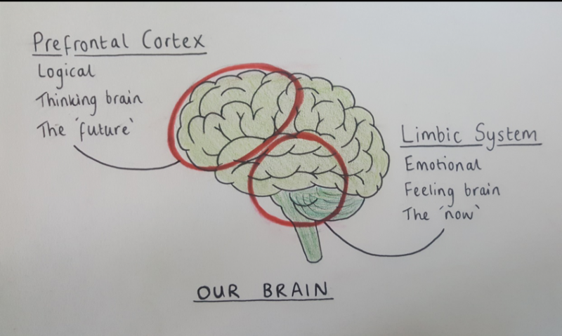

THE SCIENCE…………………
Prefrontal cortex
Planning
Setting priorities
Organising
Working memory
Impulse control
Limbic system
Fight , Flight or freeze stress response
Emotional part of brain
Motivation
Memory
Notes:
Lets think a bit more about the science of what is happening in the teenage brain. So if you look at what the prefrontal cortex's role is and think about in teenagers it isn't developed, it helps us to understand the things they struggle with such as being organised – think about the transitions they undergo, especially going into S1 where they have to be organised and remember their timetable, books and much more on a daily basis.
The limbic system being the most developed part of the brain helps us to think about some of the mood fluctuations we might see. Some of the other changes that we notice in this stage of development are:
Sleep – melatonin that chemical in our brain that helps us to sleep starts to be produced later in the evening meaning that bedtimes become later.
Inability to read faces and understand what people might be thinking - Pictures of the brain in action show that adolescents' brains work differently than adults when they make decisions or solve problems. Their actions are guided more by the emotional and reactive amygdala and less by the thoughtful, logical frontal cortex. ... misread or misinterpret social cues and emotions.
What we must remember is that this is an important stage of their development. Relationships are really key. There is also a window of opportunity to support young people and change outcomes for them if they have experienced adversity in their earlier years.
The brain is also like a sponge for new learning as Dan Siegel will talk about in the video on the next slide.

Slide 6

Notes:
Dan Siegel, in this video helps us to think about teenagers and how we can capture their strengths and deepen our understanding of this developmental stage.

Slide 7

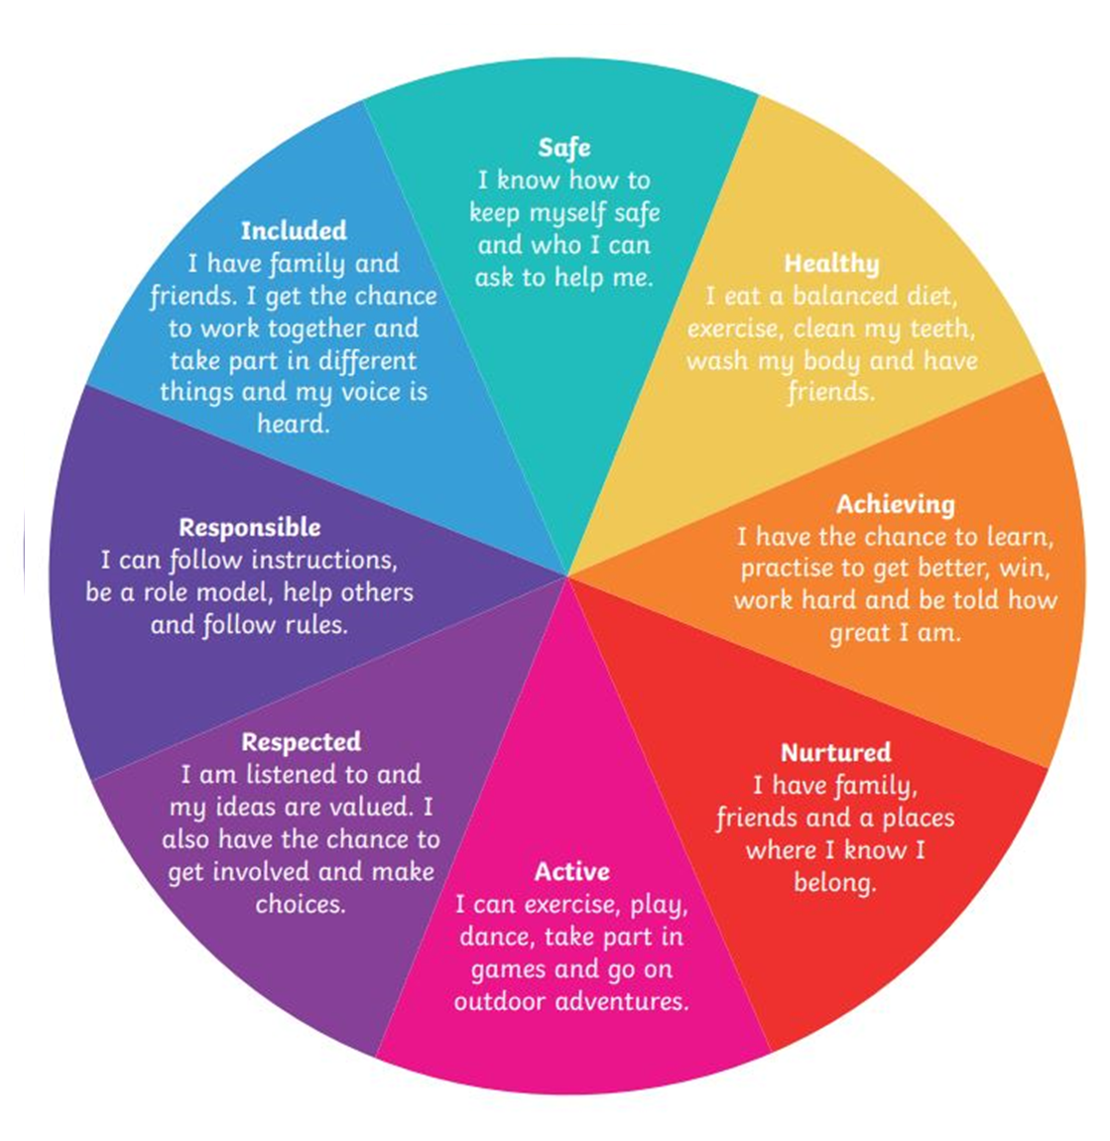
Wellbeing Indicators
Notes:
If the prefrontal cortex isn’t working then we, as adults around teenagers, need to step in at times and be their prefrontal cortex. If we think about the wellbeing indicators and how they assess our wellbeing it helps us to think about the tasks we need to support them with to in turn support their wellbeing.
For example - Safe – teenagers like to engage in risk taking behaviours due their brain not being able to think ahead, plan and assess situations – sometimes we need to support them to think about this, do the planning and help them to assess situations and prepare for them.
This is a good blog to read to have a better understanding of how teenagers might be managing at the moment Getting through lockdown together with teenagers

Slide 8
Supporting distress
We all show distress in different ways
The following will help you to think about your role in supporting the young person…..
C – Change is important - have you noticed a change in their presentation?
H - How can I help? Approach?
A – Ask how they are? Listen and ask about potential crisis?
N – Normalise feelings
G – Guide to resources
E – Engage regularly
S – speak to professionals for support - consultation
Notes:
These steps help to think about what you might notice and how you can respond.

Slide 9
CHANGES…step by step………
Change is important – have you noticed a change in their presentation?
Things you might notice are:
Withdrawing from activities and social interaction
Showing signs of tiredness, low energy and reporting not sleeping
Changes in mood – low mood or sadness
Expressing excessive fears
Struggling to concentrate
Generalised worries/anxiety
Being irritable and/or angry
Self-harm
Using negative language to talk about themselves or their life
C
Notes:
This helps you to think about what you might have noticed, the changes from normal presentation. Some of what you might observe might be normal teenage reactions, but if you see that some of these are happening regularly and persistently you might want to think about what you could do.

Slide 10
CHANGES…step by step………
How can I help? Approach?
How to start a conversation about mental health? Should I approach them and tell them what I’ve noticed?
You can start a conversation in the way that you normally would. Sometimes talking about the weather, music or other things you would normally chat about is a good starting point.
Starting a conversation about mental health can start with …I’ve noticed that you’ve not been yourself
H
Notes:
You might have observed changes in a young persons presentation. You might be wondering if you should approach them. Consider if you are the right person or is there someone else that they might have a relationship with, think about when you do this, how you do it.
Always be respectful to the young persons privacy. They might not want to take you up on your offer to chat. That's okay but if you are worried about them, share with the team.

Slide 11
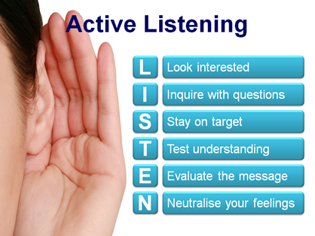
CHANGES…step by step………​
​
A
Ask how they are? Listen and ask about potential crisis?​
You could move the conversation onto addressing your concerns saying that you have noticed a change in how they are.... is there anything that you would like to talk about?.....Can I help you? How are you feeling?
Remember to listen.......
Notes:
Finding ways to be direct and ask people how they are is easy but sometimes the answer can initially be 'fine' we are all masters at trying to avoid talking about what is happening for us. How are you? Can I help you? Is there anything that you would like to talk about?
Remember to be a good listener and to stay with the young person and not try to fill silences or take the conversation off focus.

Slide 12
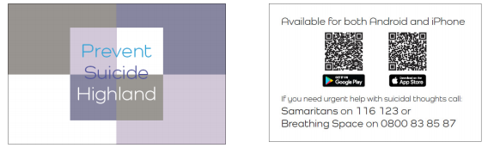
CHANGES…step by step………
Ask about any crisis?
Asking about suicide – see this SAMH guide here
You can also download the Highland Suicide prevention app
for Apple here and Google play store here
A​
Notes:
The worst crisis that a young person could be experiencing is that they are having thoughts of suicide.
It's really important that you ask this question as it will be hard for the young person to tell you this. People often worry that asking about suicide can put the idea in someone's head if they hadn't thought about this already. There has been research about this and this is not true. If someone is having thoughts of suicide they will be relieved that someone is asking them and will be able to answer. If they don't they will know that you are someone who is willing to talk about suicide and they could discuss this with again in the future.
When you ask about suicide it is important to ask directly – some examples of ways to ask are:
Sometimes when people feel the way that you have been describing to me they might be thinking about suicide, are you thinking about suicide?
Do you have thoughts of suicide?
If you are aware that a young person is self harming you should ask them if they are having thoughts of suicide. 52% of young people reported to have died by suicide in a study by Manchester University had previously self harmed. Not everyone who self harms does have thoughts of suicide but it's important to ask so that you know how best to help them.
If the young person says yes they do have thoughts of suicide, you can ask them the following:
Is that because you want to die?
Or is it because things feel so overwhelming that if you could press 'pause' until things felt easier to cope with you would?
You should also ask if they have a plan and find out what that is – do they have a timeframe.
For a lot of young people just talking about things diffused the feelings but not for all. Please make sure that you share concerns with appropriate people and use the Highland Practice Model to help you think about what is shared.
You can also speak to the assigned PMWH for the hub you are working at.
If there are serious concerns about immediate risk please phone the duty line at the Phoenix centre to discuss.
It is important to remember normal child protection guidance and discuss with others at the hub what you might need to share with parents.
When you spend time talking to a young person a lot of the worries that have caused the distress will be diffused and it will allow them time to think about some of the more pressing concerns.

Slide 13
CHANGES…step by step………​
Normalise feelings
Validating and normalising big feelings helps them to become more manageable
Guide to resources
CAMHS resources
Learn4mentalhealth
Staying safe
Ideas for self care
N
G
Notes:
Normalising feelings is helpful to let young people know that their emotions are things that everyone experiences and there is no shame in having the e.g. I get angry when people do things like that too – or 'those are normal feelings to have when things like that happen'.
Taking a young persons distress seriously and acknowledging their experiences as valid for them is very healing and it is good practice for building their empathy with others too.
Helping guide young people to resources that might help them can help. Sometimes they might need some support to think about what would be helpful. The CAMHS website has a range of resources for different things. You can both look at it from an acceptable distance and talk through what might be helpful.
The Wellbeing site has a wellbeing plan that young people could complete as well as some good ideas about looking after their wellbeing.
The Highland Suicide app and the Safety planning site also have safety plans that can be completed by you and the young person.

Slide 14
CHANGES…step by step………​
Engage regularly
When?
How?
Speak to professionals for support – consultation
Link Primary Mental Health Worker or Educational Psychologist
E
S
Notes:
Engaging regularly with a young person is important. A check in with them can be done on a 1:1 basis but can also be done other subtle ways. It's important to let them know that you will want to make sure they are okay and they can help you to think about what is an acceptable way of doing this. You might agree that you will meet with them once a week but they can also let you know if they need to speak to you more often than that – maybe agree a signal for this as asking for help can be hard.
Speaking to professionals – if you feel that you would like to speak about a young person and your concerns please contact the assigned Primary Mental Health worker and/or Educational Psychologist. They can provide you with relevant support and help to think about if other support is required.
Further learning for teachers re mental health by SAMH can be accessed here

Slide 15
Looking after ourselves …....
It is important to remember your own emotional wellbeing/mental health. Supporting others is important but we need to think about how we look after ourselves.
Think about your own self-care – make time for yourself.
Talk about any issues that you feel you are 'still thinking' about with others.
Think about the supports that you have and how you can use them if you need to.
Notes:
Please remember that you are important. Discuss cases with the link professionals – PMWH and EP.
Some of the resources below might be helpful:
http://learn.4mentalhealth.com/
https://www.stayingsafe.net
NHS mental health and wellbeing website

