Slide 1

Recovery and Return to Learning
Approaches for Early years professionals
With thanks to COVENTRY special educational needs and disability (SEND) Support SERVICE
www.coventry.gov.uk/recoverycurriculum

Slide 2
Overview
The impact of COVID 19 on the lived experience of children.
1
People’s experience of Trauma.
2
How to support children with their transition back to nursery school.
3

Slide 3
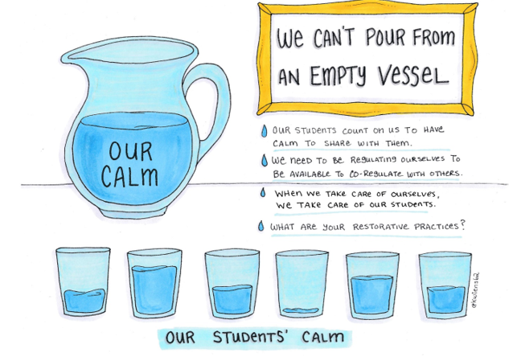
Helping ourselves to help others…

Slide 4
1
The impact of COVID 19 on the lived experience of children.

Slide 5
How has COVID 19 Changed the lived experience of Early Years Children?
Loss of connection
Loss of structure and routine
Loss of opportunity
Loss of freedom
Notes:
Help children recover from whatever children have experienced during this pandemic. Some might be quite minimal e.g. just missing their friends other will be much worse (young carers, loss of family members)
Loss of friendship: you cannot underestimate the impact of the loss of that social interaction. It is as key to their holistic development as any lesson. Human beings are fundamentally social creatures, and the brain grows in the context of meaningful human to human interaction. When this is taken away, it has negative impacts. When this even when children return to school, their experience of play time will be very different (i.e. social distancing)
Loss of Structure and Routine: Children need to know what they are doing now and what will come next. If they don’t, the child will become anxious and concentration levels drop; they become frustrated with themselves, and their parents as makeshift educator.
Loss of Freedom: (links more with older teenagers)
Loss of opportunity: e.g. examinations “I was preparing to run a marathon, but now they tell me there is no race!” Many would think that the removal of examinations would be a matter of joy for most young people facing a gruelling timetable of examinations. But these are rites of passage; they are integral to how that young person shapes their ambitions for their life. What impact will it have on students to give their all to examinations next time around?”

Slide 6
What impact might this have?
Loss of connection
Loss of structure and routine
Loss of opportunity
Loss of freedom
Anxiety
Bereavement
Attachment
Notes:
Impact of Loss
From loss emanates three significant dynamics that will impact majorly on the mental health of our children. Anxiety, trauma and bereavement are powerful forces. For them all to appear at once in an untimely and unplanned fashion is significant for the developing child. Our children are vulnerable at this time, and their mental-health fragile. And on top of that, they are witnessing a sea of adult anxiety, which they unwittingly are absorbing. There will be many students who are young carers, and this loss of freedom will be combined with a weight of responsibility that will have made academic learning feel inconsequential
The loss of friendship and social interaction could trigger a bereavement response in some of our children. They will grieve for that group of peers, who not only give them angst, but also affirm them as the person they want to be. The rules of the peer group have vanished without warning, and our young people in particular, were ill prepared for this. They will mourn for how their life was compared to how it is now. They have undergone a period where friends and family members have been avoided because they are a threat; how long will it take for children to feel not threatened by nearness of others?
The loss of routine and structure, will be traumatic for some. Already we are receiving reports of the increased incidents of self-harm, (Young Minds, 2020). Children can find it alarming that the infrastructure of their week has been abandoned however logical the reason. The suddenness of it all may induce panic attacks, a loss of self-control, as the child feels their own intellect no longer informs their personal judgements accurately.
Anxiety is a cruel companion. It eats away at the positive mental health of the child, and can cause a deterioration in their overall well-being. The anxious child is not a learning child. Mood swings may prevail; they can become irrational and illogical. There can be a loss of sleep; the cumulative tiredness can diminish the child’s coping mechanisms.
So children might be experiencing heightened levels of emotion and EC is a way of supporting children though these emotions

Slide 7
2
People’s experience of Trauma.

Slide 8
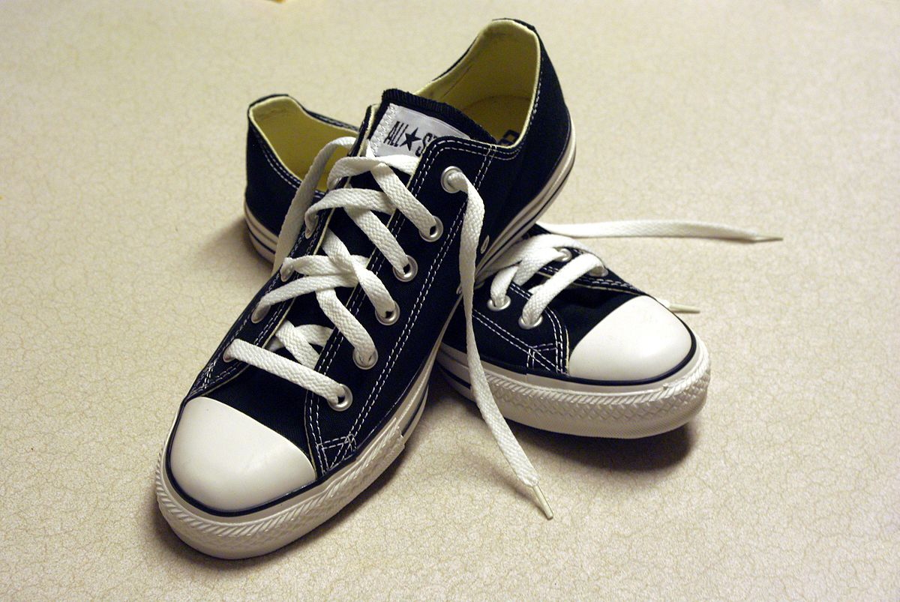
What are crisis and trauma?
A crisis is an event that is going to lead to an unstable or dangerous situation affecting an individual, group, organisation or society.
The term trauma can be used to describe a person’s response to a crisis, when their usual coping mechanisms are overwhelmed.
Different people are likely to respond to the same crisis differently.
When trying to understand a person’s behaviour, it can be helpful to ‘stand in their shoes’.

Slide 9
How do People Respond to Trauma?
During a crisis, people may experience:
Flashbacks and intrusive memories
Vivid dreams
Headaches
Difficulty concentrating
Feeling guilty typically ‘it was my fault’
Feeling detached from others
These things are “a normal reaction of normal people to events which, for them, are unusual or abnormal” (Parkinson, 1993)
If these symptoms emerge later, persist or intensify long after the event, then more specialist support may be needed.
Notes:
Most important thing to understand is that it is normal for people to respond to trauma.
Sometimes, when we try to support people after a traumatic event, our instinct is to try and make things better to reduce the negative emotion.
Sometimes, when we work with people also worried that there is a process that needs to be followed after a traumatic event, and that if we deviate from this, it can harm the person.
But, in most cases, when supporting a person in the time immediately after a traumatic event, we can expect to see an emotional response.
Normal reaction to very unusual circumstances.
Depending on the significant of the trauma and the person’s perception of it – might see…
Be there, listen, hear, engage at a human level.
When we support schools following a critical incident, we do not deliver therapy- we do the very same things.

Slide 10
Ways in which EYs children may respond to trauma
More extremes of emotion, e.g. crying for longer or more easily
Unusually quiet responses
Unusually aggressive responses
Regression – e.g. toileting accidents, wanting to be fed by parent, wanting to play with toys that are ‘too young’
Separation anxiety - becoming distressed when they are dropped off at the setting and/or worrying about if/when their parent will come back for them
Loss of interest in activities that they have previously enjoyed
Playing repetitively with a favourite toy
Acting out a traumatic event during a role play activity
Disturbed sleep
Deliberately hurting themselves

Slide 11
3
How to support children with their transition back to NURSERY/ELC

Slide 12
The five pillars of recovery
Safety
Connectedness
Self and community efficacy
Hope
Calm

Slide 13

Foster a sense of safety
In Early Years
Establish new routines. Explain the routines to children and support them to understand and remember them by using visual structure, e.g. objects, picture labels, visual timetables, now and next boards.
Use simple songs linked to routine events.
Answer children’s questions honestly using simple language. Follow their lead; some children will want to talk about what they have experienced; other children may express themselves in different ways.
Try to avoid having conversations with other adults in children’s hearing about traumatic events; children are likely to overhear and not fully understand.
Provide appropriate resources for symbolic play.
Print off photos of family members for children to use as comfort objects during the day.
In Primary Years
There will be new routines in place. For example, regular hand washing and staggered lunch breaks.
The timetable will be very different: no assembly (could be a positive for some), lunchtime and playtimes will feel different.
Not knowing when restrictive measures will end may create uncertainty.
Provide clear and simple information about new routines. Use visuals to support where possible.
Involve children in considering how best to support adherence to the new rules, e.g. by designing a socially-distanced classroom, or by making posters to share the rules with others. Pupils debate and defend their designs.
Re-establish familiar routines and introduce new activities to help punctuate the day.
Prepare transition work for children in key year groups,
Provide opportunities for children to talk and ask questions. Consider setting up a worry box.
In Secondary Years
Students not accustomed to the strict routines of the school day – might struggle to get back into routine and ‘learning habit’, might struggle to respond to expectations of staff.
New way of working in school – understanding the reasons and the rules – although returning to a routine, it will not be not be the routine the pupils are used to (length of day, classroom, staff, school routines such as assembly, break and lunch, access to toilets etc)
New structure re hygiene – difficult to monitor in secondary school
New structures required in school re managing of learning resources – handing out of worksheets, exercise books etc, and collecting in and marking? Practical lessons such as Science, PE etc
More freedom at home regarding the time-frame for learning – might struggle to concentrate for prolonged periods of time.
Preparing the pupils for what will be the same and what will be different (some will need more scaffolding than others).
Support this with visuals of the school day to support anticipation of the new structure.
Building in more regular movement breaks during periods of learning to support concentration
Opportunities to talk, as appropriate.
Provide a safe and regular space for students to talk about COVID-19 related issues.
This Photo by Unknown Author is licensed under CC BY-SA

Slide 14

Create a calm environment
In Early Years
Label emotions as the children are experiencing them and validate how the children are feeling.
Model noticing how people are feeling and comfort them, support them or celebrate with them.
Involve children in calming breathing exercises as part of your new circle time routine.
Keep activities simple. Revisit activities that the children have enjoyed in the past.
Respond calmly to children who are struggling to stick to new rules and routines.
In Primary Years
In the early stages, both staff and students may feel anxious about returning to face to face learning.
There may be less time available within the school day.
Classrooms will be calmer and the school will be quieter, due to there being fewer children on site.
Check your own support networks.
Make time each day to complete activities that you enjoy and which are not work related.
Schedule time to complete a grounding activity at the beginning of the school day, such as a shared story, news or circle time.
Schedule time to complete calming activities, such as meditation or mindfulness.
In Secondary Years
In the early stages, both staff and students may feel anxious about returning to face to face learning.
There may be less time available within the school day.
Classrooms will be calmer and the school will be quieter, due to there being fewer children on site.
Check your own support networks.
Make time each day to complete activities that you enjoy and which are not work related.
Schedule time to complete a grounding activity at the beginning of the school day, such as a shared novel or circle time.
Schedule time to complete calming activities, such as mindfulness.
Consider playing calming background music during work time.

Slide 15

Build connections
In Early Years
Display pictures of children and staff who are not currently at setting or who are attending but in a different room. Talk about them and share stories about what they are doing.
Build relationships through playful interactions. Join in with what the children are doing and follow their lead.
Play simple board games in small groups
Create collaborative pieces of art work
Use video calls to keep in contact with children who are not attending the setting.
In Primary Years
There may be changes in friendship groups (due to the limited number of children in each class), children may not be able to be with all their friends. .
New adult relationships may need to be developed and children may not have access to the adult they have a strong bond with
Cooperative play may be limited.
Be vigilant for bulling, which may look different, for example: the “COVID-kid”, ‘Poor’/’Vulnerable’ kids who were in school hubs.
Spend time helping children to establish and adapt to new friendship groups.
Consider new ways of playing – e.g. socially-distanced games
PSE friendship work
Write letters to people in care homes to build new connections.
Consider revising protocols for responding to incidents of bullying.
Design quizzes for peers in other year groups to go on school website.
Debates that promote turn taking and listening to each other
In Secondary Years
Might have had very limited remote contact with friends during lockdown – leading to possible feeling of isolation. They may be unsure of how they fit into their friendship group, needing reassurance,
Some students may possibly lack the skills needed to re-integrate.
Limitations on new classroom and group structures might continue to limit the rebuilding of friendships – might lead to difficulties in maintaining friendships and difficulties managing related emotions.
Breakdown of relationships with staff due to lockdown - needing time to feel comfortable with staff again
Provide opportunities for structure during non-curriculum time in order to regain confidence with peer relationship.
Provide opportunities to share experiences abut lockdown.
Participation in friendship groups in order to facilitate the rebuilding of relationships and explicit teaching of skills as appropriate.
Rebuilding relationships with staff through ‘team building’ type activities
Support in re-visiting and repairing their ‘self-image, self-esteem and self-concept’ to support re-integration into friendship group
This Photo by Unknown Author is licensed under CC BY-ND

Slide 16

Promote Self Efficacy
Promote self efficacy
In Early Years
Offer children choices wherever you can.
Plan activities around children’s interests.
Use specific praise to tell children what you admire about them.
In Primary
Having more space to move around in at school than at home may take some getting used to.
Out of school and extra curricular activities are likely to have been curtailed.
Children may have become accustomed to having more freedom (in some ways) during lockdown, and so might struggle with constraints placed on them in school, especially as there are new rules to follow.
Complete work on the importance of using freedom wisely and making good choices.
Provide opportunities and encourage children to take part in decision making where possible.
Allocate new responsibilities within the new class groups.
Focus on what CAN be done, e.g. sports, arts and music.
In Secondary
Students may be used to having more free time during lockdown, and so might struggle with constraints placed on them in school.
Not used to the amount of physical freedom they have on the return to school - might act in a silly way, leading to difficulties
Possible fear of the increased freedom when the virus is still around, and being allowed out without other members of their household might escalate anxieties
Possible lack of personal organisation of materials and learning equipment due to being out of the habit
Loss of opportunity to sit exams and learning towards these – might lead to loss of engagement in, and motivation for the learning. ‘What’s the point when I’ve missed so much?’
Complete work on the importance of using freedom wisely and making good choices.
Provide opportunities and encourage students to take part in decision making where possible.
Allocate new responsibilities within the new class groups.
Focus on what CAN be done.
Consider alternative ways of providing feedback on performance and marking rights of passage.

Slide 17

Offer Hope
In Early Years
Share ‘good news’ with children.
Involve the children in planning favourite activities for the next day or for later in the week so that they have something to look forward to.
Recognise children's efforts, achievements and successes.
Feed back to families about their children’s achievements – you can be a source of hope for them too.
In Primary Years
Children will be at different stages, for example their parents may be shielding or may have experienced bereavement.
There might be a loss of engagement in, and motivation for, the learning, and a feeling of ‘What’s the point when I’ve missed so much?’
Out of school activities will have been curtailed.
Still a level of uncertainty around the ‘return to normality’.
Share good news.
Try unusual art / craft activities. Provide opportunities to develop new skills.
Create opportunities to recognise achievement,
Putting work on the school website to show peers in other year groups
Opportunities to share experiences in some form of project work – possible focus on what has been learnt from the experience, moving forwards etc (opportunities for cross-curricular work on different aspects of this).
Opportunities to receive expert support for loss and bereavement if appropriate
In Secondary Years
Renewed opportunities to leave the house and start to build relationships and normality – might lead to a mixture of excitement for this return to a more normal way of being, but also anxiety related to the virus (especially if they also have vulnerable family members or have links to anyone who has passed away) and present in anxiety-related behaviours.
Opportunities to extend their friendship group through new classroom groupings – possibility of changing dynamics of friendship groups and the impact of this on individuals
Share good news.
Try unusual art / craft activities. Provide opportunities to develop new and different skills.
Create opportunities to recognise achievement (badges / credits).
Opportunities to share experiences in some form of project work – possible focus on what has been learnt from the experience, moving forwards etc (opportunities for cross-curricular work on different aspects of this).
Opportunities to receive expert support for loss and bereavement if appropriate.

