Slide 1



Staff wellbeing
Looking after you……

Slide 2
Wellbeing
Our wellbeing helps us to think about our health in a holistic way. This includes our physical and emotional health. When we have good wellbeing we might feel that life is balanced and that we can cope. We might feel motivated and engaged and be resilient to cope with issues that can impact us on a daily basis. We will also be more likely to ‘bounce’ back from challenges that we encounter.
Notes:
In order to support the wellbeing needs of the children that we look after it is really important to think about our own. If our own wellbeing needs are met then we will be better able to support others. It’s not easy though, a lot of us are masters in avoiding looking after ourselves. Perhaps the current situation is a time for you to start paying more attention to what you need to do to look after your wellbeing. Sometimes getting things back in to a balance is hard. During this training think about what you need to do and practice!
Go to http://learn.4mentalhealth.com/sites/default/files/courses/wb8/index.html#/id/5e7e0d76485e8e466da2f39a and think about how you are feeling just now!
Go to

Slide 3
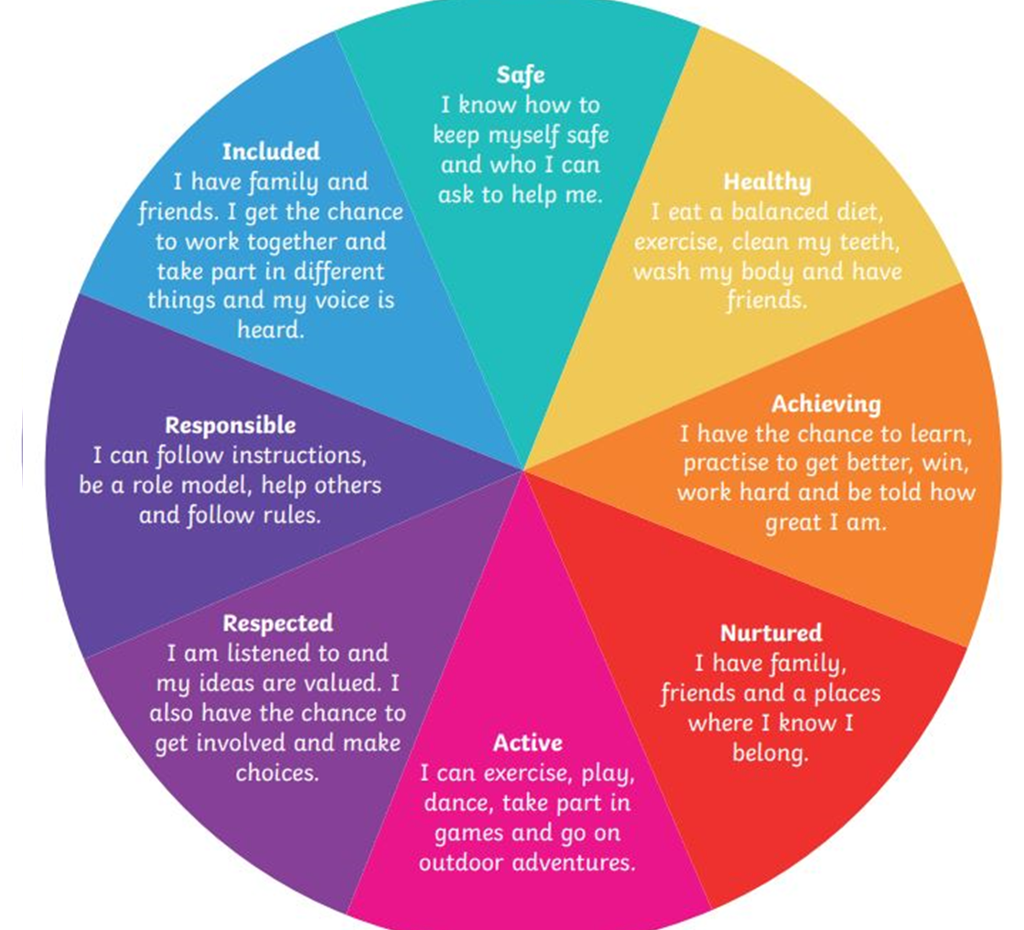
Wellbeing?
Lets think about the language that we are familiar with………….
Notes:
We use the Wellbeing Indicators all the time to think about the wellbeing of the children and young people we work with so why not think about them for ourselves. On each of these slides we will think about the continuum of when we feel these are happening and when they aren’t and everything inbetween. Spend some time reflecting on what you do or could do on each one to bring it back to the left.

Slide 4

Safe
Family
Routine and consistency
Trusted people
No risk of harm to self or loved ones
Comfort
Distress
Notes:
We are living in unfamiliar times. Our routines have changed, our social networks have changed, how we work has changed. Change can make us feel unsettled. The stories that we hear in the media can make us worry. We can’t see some our loved ones or we worry about their health. That means that we can go from feeling well and having good wellbeing to having feelings of distress and discomfort and back again in a short space of time. Our natural coping strategies are still there but sometimes we need to search about for them and be reminded of ways we have coped in the past.
These are normal feelings and reactions to have.
Think about what you need to do to feel safe.

Slide 5
Healthy
Physical and Mental Health are interlinked
Sleep
Exercise
Diet
Access to healthcare
Resilience
Relationships
Coping strategies
Optimal health
Ill health
Notes:
Our physical and mental health are interlinked. If we pay attention to what we need to be physically healthy it will also support our emotional wellbeing. Think about the impact of exercise and although we can make lots of excuses not to do it when we do it makes us feel better. We can get into habits of eating comfort and convenience and sugary foods that although make us feel good at the time can have a longer term affect of making us feel sluggish and meaning that some of our normal bodily functions are slowed down. Poor sleep can also impact on us. Think about what you have to do to help you slide back to the optimal health when you are up at the top end.
More about our mental health on the next slide.

Slide 6
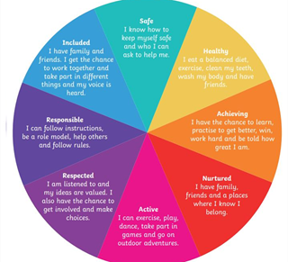
Mental Health Continuum
Experience Understanding
Environment -what’s happening
Developmental Stage Self awareness
Mental Health & Well-being
Mental Health
Difficulties
Genes
Relationships
Health
Notes:
We all have mental health and different ways of managing it. If we have mental health difficulties we can still have good wellbeing.
If we think about it as a continuum – it can move up and down by the week, day, hours, minutes depending on what is happening. What helps us and influences this are:
Our environment – what is happening for us – this could be at home, work or other.
Our experience and understanding of what is happening and our reactions to it – have I felt like this before, what helped in the past?
Our developmental stage – thinking about our stage of life - at different times in our life we might be more or less self aware.
Relationships are always key! We are social animals. Think about who you have in your life who supports you, who you can talk to or rant at!
Health – our health can impact how we are feeling, at the moment even just being anxious about getting ill can impact us considerably.
Genes – Our genes are important as they can make us more vulnerable to physical or mental ill health.
All of these together can influence how you cope when we are struggling to manage.

Slide 7
Achieving
Becoming competent with Google classrooms
Supporting family
New hobbies/skills
Working out what distance 2 metres is so you can socially distance
Achieving loads
Achieving nothing
Notes:
You will definitely be achieving loads at the moment but not giving yourself enough credit for doing so! Think about all the new learning that you have had over the past few weeks. Your knowledge of IT systems and how they work (and don’t work) will have developed. If you have been working in the hubs you will have had to adapt to support children in a different way and maintain social distancing. Sometimes the feedback will be delayed so please remember to pat yourself on the back!
If you feel that you are on the right of the continuum – reflect on how you have spent your time over the past few weeks. Give yourself credit for all that you have achieved.
There might be feelings of loss around not being in control of your pursuit of knowledge but that’s normal. There are lots of people offering training and learning for free – see if there is something that you would like to join in with but at the same time please don’t feel you have to! Thinking about how you look after yourself requires a lot at the moment – just see that getting through the day can be an achievement especially with all the change we have experienced! Don’t beat yourself up!

Slide 8
Nurtured
Finding ways to keep in touch with others
Self care in whatever form suits you
Doing what you need to protect your physical and mental health
Feeling nurtured
Feeling neglected
Notes:
Feeling nurtured is especially important at times like this. The relationships that we have help us to feel nurtured. Some of those relationships might having to be kept in contact with in ways that are very different from what is normal. Keep in contact though – phone people, use video calling. Think about what you need to do to ‘nurture’ yourself at the moment. We can feel like we need to be doing things and keeping busy – make time to just be – think about some self care ideas – buy a book, download some music, sit and enjoy the garden, going for a walk – we all like different things so choose things that suit you. The resource learn4 mental health – in the resources section will give you ideas.
If you are helping others – know your limits. Think about where you are on the continuum and what you need to do to get yourself back to the left hand side. We can often neglect our own needs because we are looking after others needs and forgotten about ourselves. Be compassionate to yourself.

Slide 9
Active
Being mobile
Exercise
Spending time outdoors
Active
Inactive
Notes:
Being active is tied up with being healthy. At the moment the time we can spend outdoors is curtailed – how can we make the most the time we are allowed to be outdoors? Keeping active is good for our emotional wellbeing. As well as the obvious activity try and find other ways to exercise, get up off the couch every half an hour and march on the spot ….be creative!
Be mindful of how you are feeling when you are towards the right hand side of the continuum.
If you are working at home and would normally be quite mobile in your job – make sure you get up and walk about regularly to stretch your legs.

Slide 10
Respected and Responsible
Feeling listened to
Able to make choices
Helping others
Following rules
Feel it
Don’t feel it
Notes:
Feeling respected is important – when we feel listened to it helps us to build our confidence and self esteem. The ability to make choices is important at a time when we have our choices limited.
Being a role model and helping others and following rules seems to fit what is being asked of us at the moment. We might be supporting others within our family to do this.
Be mindful of how you are feeling when you are towards the right hand side of the continuum.
Please remember that being at home might bring up difficulties with relationships that we might have ignored or not noticed. If you feel that these start to impact on your feeling safe that you reach out for help. Ideas for help are in the resources section.
Feeling responsible for many others who might be looking to you to help them can make us feel tired. Remember to look after yourself.

Slide 11
Included ……
Feeling included helps us feel a sense of belonging to things like………
Work
Home
Family
Friends
Community groups
Church
Included
Isolated
Notes:
Feeling included helps us to think about feeling a sense of belonging. We can feel included when we walk into work and feel part of a team, when we are at home and with family. When we meet friends or attend community groups to do sports or attend church. It’s important to think about at the moment how this will have changed with the lack of social contact and getting used to interacting in different ways with those that we used to see regularly.
Think about how you stay in touch and interact in different ways – using video calls, phoning more often. Others will be feeling the same way so will be glad to hear from you. Think about the people that help you to feel included – also think about how you help others feel included – can you link in with them in a different way.
If you are working in the hubs you will have had to get used to different people, routines and buildings. It can take a while to feel included in the new environments.

Slide 12
Rate your wellbeing………
Stop, relax, close your eyes and reflect where you think you are overall on the continuum…….is there one thing that you could do to support it……. commit to spending at least 10 minutes on something just for you!
Feeling good
Not feeling good
Notes:
We use the Wellbeing Indicators all the time to think about the wellbeing of the children and young people we work with so why not think about them for ourselves. On each of these slides we will think about the continuum of when we feel these are happening and when they aren’t and everything inbetween. Spend some time reflecting on what you do or could do on each one to bring it back to the left.

Slide 13
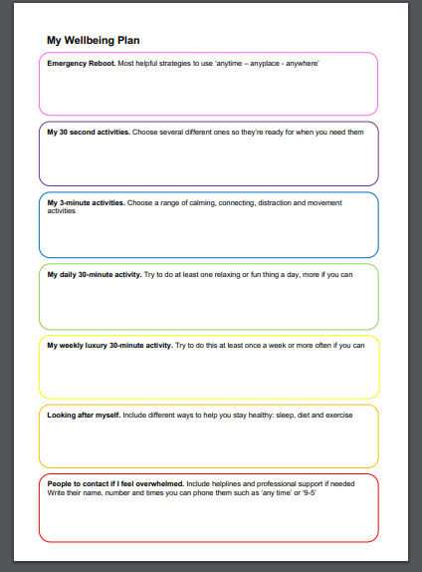
Useful Resources
Learn4mentalhealth - has great tips for our wellbeing including a wellbeing plan
Clear your head Scotland
NHS Fitness studio
5 Ways to Wellbeing
Explore all of our mental health self-help guides
Learn about managing stress
Learn different ways to improve your mental wellbeing
Mental Wellbeing Toolkit at http://www.highlandmentalwellbeing.scot.nhs.uk/
Prevent Suicide - Highland App - https://play.google.com/store/apps/details?id=com.faffdigital.PSHighland
https://www.facebook.com/highlandmentalwellbeing/
Womens Aid
Please remember that your GP is someone you can go to and will be able to signpost you to other support if required.

Slide 14
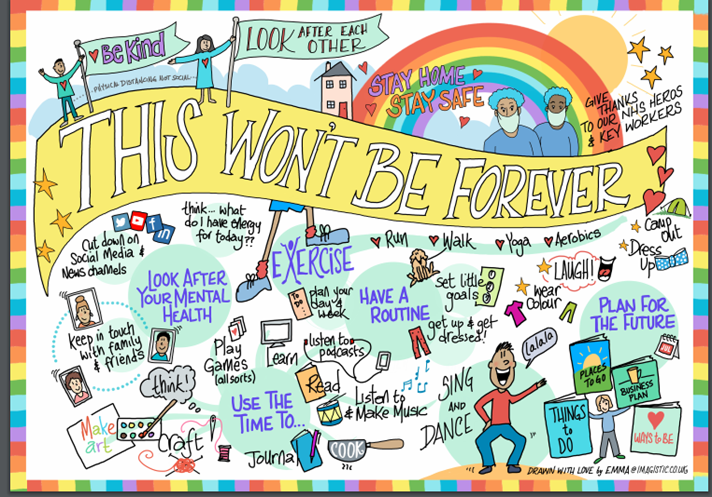
Notes:
Remember this isn’t forever but your wellbeing is….whatever you make time for now will benefit you forever!

