Slide 1

Promoting Positive Relationships and building Emotional Literacy in School Hubs
What it is and why is it important

Slide 2
Unusual Times
We are in unusual times right now, but must ensure that staff who continue to work with children and young people follow the agreed guidance and policies available within Highland Council.
This short training module is a summary of some of the key messages provided to staff who work with children and young people.
Further information on any of the information contained in this module can be accessed on the Highland Council website https://www.highland.gov.uk/info/886/schools_-_additional_support_needs/1/support_for_learners or by contacting bernadette.cairns@highland.gov.uk

Slide 3
Contents
TOPIC | SLIDES
Behaviour and Self-Regulation | Slide 4-10
Emotional Literacy and Emotional Coaching | Slide 11-19
Stress and Trauma | Slide 15-25
Resilience and Self-Esteem | Slide 25-30

Slide 4
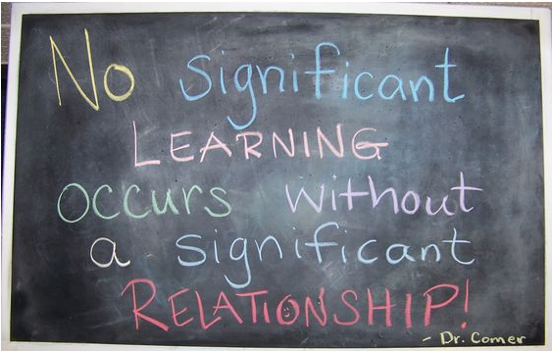
J. P. Comer
Notes:
There are many research studies that have shown the power of relationships and the necessity of these, in supporting the conditions that enhance learning in both adults and children.
We always need to spend time building team, relationships and trust, especially at the start of any endeavour. Without trust, we will be worried about how we look, what others think, how we are perceived etc. we will be looking for threat and trying to avoid embarrassment and shame and spending our brain power and problem solving skills doing this, rather than playing, engaging, processing information and learning in a relaxed way.

Slide 5

ALL behaviour is COMMUNICATION
Feeling Thinking
I don’t feel OK
Anxious and not often in control
Not confident and seldom achieve success
People are out to get me
I can’t do it, so what’s the point
The worst will always happen?
Behaviour
Not confident when interacting with the world and others
Can’t regulate my stress, anxiety or fear and feel threatened by failure
Notes:
Behaviour is linked to our thoughts and feelings about a situation, which in turn are coloured by the way we look at the situation (our perception of it). So if we haven’t yet learned that the world can be a positive place, or our thinking about ourselves is negative, this will have a knock on effect to how we feel and behave.
Behaviour is just the expression of how we are feeling or what we are thinking and for a child with little or no language (either literally, or no specialist language to express how they feel or what they fear), it is the only way they can communicate with us. So we need to get good at accurately interpreting what this means and what they are trying to tell us.

Slide 6
Feeling Thinking
I feel OK
Anxious but in control
Relieved and confident when successful
Things will be OK
If I practice I’ll improve
What’s the worst that can happen?
Behaviour
Interact with the world and others confidently
Manage my stress, anxiety and fear and learn from success and failure
Positive Relationships aid feelings of trust, safety and security, reduce stress levels and support better cognitive functioning.
Positive relationships are more conducive to collaborative working among teams and higher levels of job satisfaction.
Notes:
To change our thought processes and our feelings and behaviour, we therefore need positive relationships with others, to develop trust and security.

Slide 7
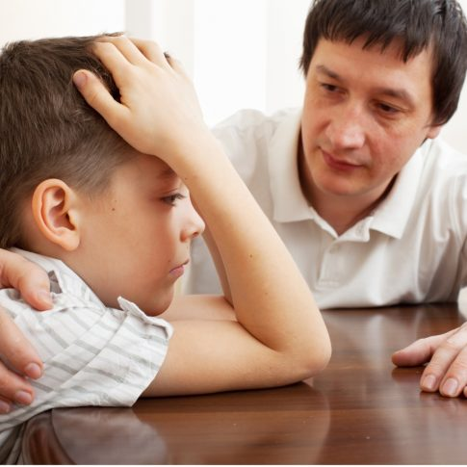
The Importance of
Emotional Regulation
When we are present with children and compassionately aware of our own emotions, we preserve the most precious factor in a child’s process of developing self-regulation: human connection
Mona Delahooke
Notes:
We especially need to build those positive relationships with children who haven’t yet learned to self regulate their emotions and their behaviour.
Generally by age 3 or 4 a child will start to develop the capacity to self regulate and this then continues to develop through childhood. However, this develops through co-regulation with a significant adult. With the adult noticing and attending to the child’s emotional and physical needs. A baby cries when they are hungry and if they are lifted and fed, they learn how to wait a little longer as they know food is coming – it usually does.
If these types of caring responses are consistently provided by the caregiver, they form the building blocks that eventually support wider self-regulation.
If the caregiver doesn’t respond to the child’s individual needs, or isn’t able to attune to their child, for whatever reason, eg. if food doesn’t come, the baby may continue to cry, or cry even when it is not hungry, as they can’t rely on food or the adult being there when they need them. Or, they may stop looking for attention altogether and be unusually quiet. Both are signs of distress and in neither situation will the child learn to self-regulate their behaviour if this is part of a consistent pattern from the adult.
Some older children will therefore, not have learned how to regulate their emotional responses and if we ask too much of them, before they have the neurodevelopment to manage this, we will cause shame and embarrassment. And don’t be fooled by a child who can sometimes hold things together….they will be trying very hard and using up lots of energy to do this. Just because they can control their behaviour sometimes, doesn’t mean they can do it every time.
If the child hasn’t yet managed to self-regulate their emotional responses, then they will never be successful with the use of rewards and punishment strategies to manage their behaviours and will feel shame and negativity, simply through not yet having developed the skills to enable them to be successful in fulfilling our expectations of them.
Self-regulation starts with co-regulation and so as the adults in a child’s life, we need to understand, notice and attend to their needs if we are to help them develop emotional control. And this can be at any age….not just in the early years. Developmentally, a child needs to go through this process and so for an older child, don’t assume that they can control their reactions to frustration, anger, shame or fear.
We can’t directly TEACH emotional self-regulation either, which makes it a bit more complex. It is a developmental process that we need to nurture and encourage through the experience of emotional co-regulation with the child or young person.

Slide 8
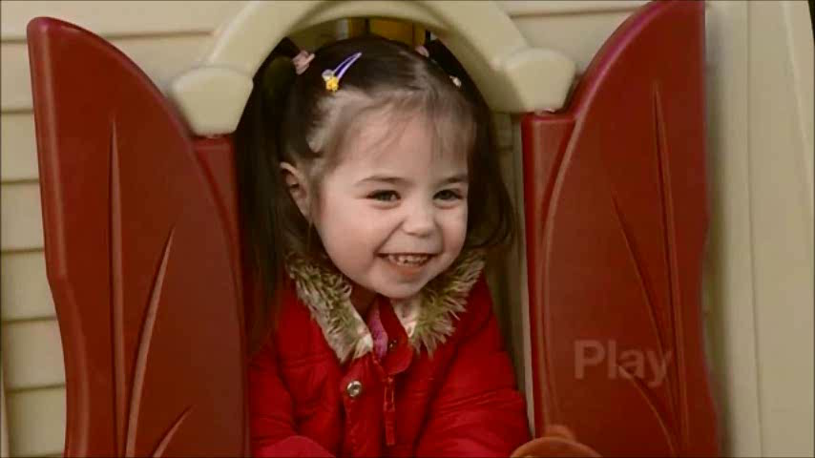
The effect of Early Relationships

Slide 9
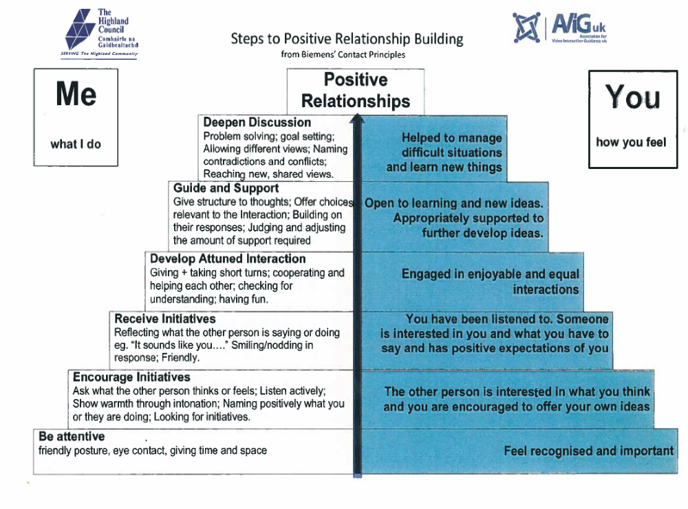
Notes:
One helpful tool in understanding the stages of developing an attuned relationship with a child or young person is the ‘Positive Pyramid’ that we have developed for use in Highland.
This is a model of how interaction and language builds relationships can support the process of co=regulation and building attuned relationships with others.
We sometimes have quite high expectations of children and young people in terms of their skills and language development and in actual fact, many of the strategies we currently use may require a higher level of skill than the children actually have.
Children can’t develop good skills if we don’t model this for them and they wont engage with us if they don’t feel we care about them. This is a hierarchy and you need to engage children by using the skills at the bottom of the pyramid first, or you will struggle to engage them in the higher order skills at the top of the pyramid.

Slide 10
The Core Conditions of Effective Relationships
Empathy – listening to you, understanding you
Unconditional Positive Regard - liking you for just being you, not conditional on what you do or achieve, not judging you, accepting diversity and welcoming difference
Genuineness – really meaning it, following through with promises, not just saying the words
We can consciously choose to offer the core conditions if we have the skill and the will.
The people to whom we find it hardest to offer the core conditions are often those who are most lacking in their current capacity to offer these us.
Notes:
In our interactions with children and especially when we are trying to support hem, we need to ensure we interact in a way that demonstrates
Empathy
Unconditional Positive Regard
Genuineness
If we can’t get beyond the behaviour, to understand where a young person is coming from or to see the underlying causes of the behaviour, we may need to consider why? What do WE need to feel safe? To be able to accept them without judgement?
Because we tend to work on reciprocal relationships, children, parents or colleagues who cant ‘give back’ what we offer to them, are often those that need these conditions to be in place most, but they may be the ones we feel less inclined to offer them to.
To be able to give without receiving back, we need to be self aware and confident in ourselves.

Slide 11
What is Emotional Literacy about?
Managing feelings that can block our ability to think and act in effective ways
Drawing on an understanding of our own emotions to help us make judgements and decisions
Drawing on an understanding of other people to help us judge, think, decide and act in our relationships.
Notes:
What underpins health and wellbeing is emotional literacy and our ability to manage ourselves and our relationships.

Slide 12
Model framework for
Emotional Literacy
Intrapersonal intelligence | Interpersonal intelligence
Self awareness | Other awareness
Self management | Relationship management
School of Emotional Literacy 2001
Notes:
This is a helpful framework to use as it allows us to think about the expectations we have on children and young people. We often expect them to manage relationships with others, when they don’t yet have an understanding of their own emotional states. It is important that we consider how we can help our children identify and recognising emotions, giving accurate labels to how they are feeling. Don’t assume they know this.
Key to our relationships and our wellbeing is ‘Self Awareness’: this is equally the case for pupils and adults. Asking children what they like to do, what they like to eat, what hobbies they have, what they find hard or easy, are all questions that can help them develop a greater level of self-awareness. If they find these difficult questions to answer, you could take photographs to show them being successful in activities and talk about HOW they were successful and managed to do these things. You could ask them what they like to do and what skills they think they use when engaging in these activities.
‘’Self Management requires the child to be good at goal setting and organisational skills. It requires them to be able to self regulate and manage their emotions, which we know many find difficult to do. It is helpful to use the language of emotions and to explain what these mean and you can ‘guess’ what emotions the child may be feeling on the basis of their behaviours, so that they can engage in discussion with you about how to manage these emotions. They might not yet have developed this language. Some teenagers still work with a very restricted vocabulary around feelings, so don’t assume this is developed.
Having ‘awareness of other’s requires perspective taking, showing empathy and putting themselves in an other person’s shoes. There is a need in this to appreciate diversity and to have respect for others. Empathy is an ‘in-built’ capacity. It develop through experiencing the empathy of others, and through ‘practice’ in communicating it. Some children have poorly developed skills of empathising with others and so asking them to think about what it feels like for someone else they may have harmed or hurt, will not be helpful for these children. Using the strategies outlines on the Positive Pyramid will model empathy and help children follow us and take their lead from us to develop these skills for themselves.
‘Relationship Management’ requires a high level of skill. Communication, social engagement and building relationships. Working co-operatively, Negotiation, refusal and conflict management. Help seeking and help providing. These are very high order skills and may vulnerable children or younger children will not yet have developed these skills. Children who find it difficult to manage relationships will need much more input in the other three areas and will need staff to model emotional literacy and to practice emotional coaching.
Emotional literacy therefore begins with being self aware and in fact, without being self aware, we can go no further with our EL development.

Slide 13
Emotional Coaching - A 5 step process to support the development of the key elements that build self esteem (John Gottman)
Being very aware of the child’s emotions and what you pay attention to. Don’t only pay attention to the negative emotions. Look for the positive ones too and comment on them. Why are they cheerful, happy, satisfied?
Recognising the moment when the child is displaying an emotion as an opportunity for teaching and intimacy. Don’t be afraid of feelings. Name them and link them to an activity, situation or event.
Being able to listen empathically and validate the child’s feelings. Use the core conditions and let the child take the lead. Facilitate the conversation.
Helping the child to verbally label their emotions. Teach the names for feelings and expand their vocabulary for their feelings.
Helping the child solve the problem - respecting any imposed limits. Consider the developmental needs of the child. Be creative and solution focused.
Notes:
Emotional Coaching was a phrase used by John Gottman to describe the way we interact and support those children who are in distress or need an adult to support them to develop emotionally and to develop their social skills. There are lots of ideas and examples of how to do this on the Gottman Institute website, but essentially there are 5 steps to coaching a child in this way. This is not a linear process, but 5 aspects of your interactions and relationship that you should be aware of when engaging with the child/young person.

Slide 14
The Emotional Coach
values the child’s ‘negative’ emotional states as opportunities for intimacy and teaching.
can tolerate spending time with a sad, angry or fearful child.
doesn’t become impatient with emotions - doesn’t want to close it off too soon.
is aware of and values his/her own emotional states.
is sensitive to the child’s subtle emotional states and can pick up changes.
is calm inside and can ‘be with’ the emotion - not confused by emotional expression.
instinctively knows what needs to be done - is in tune with the child.
doesn’t poke fun at ‘negative’ emotions.
does not say how the child should feel.
doesn’t feel he/she has to ‘fix’ the problem, but helps the child find their own solutions.
respects the child’s emotions as a source of information for them both, not something that gets in the way.
Notes:
Not everyone can be an emotional Coach and some days you are not in the position to be able to do this. Don’t try and coach a child through a difficult situation if you are not feeling great yourself. You need to be genuine if you are going to have this type of conversation and you need to have the time and the emotional energy to see it through to the end.

Slide 15
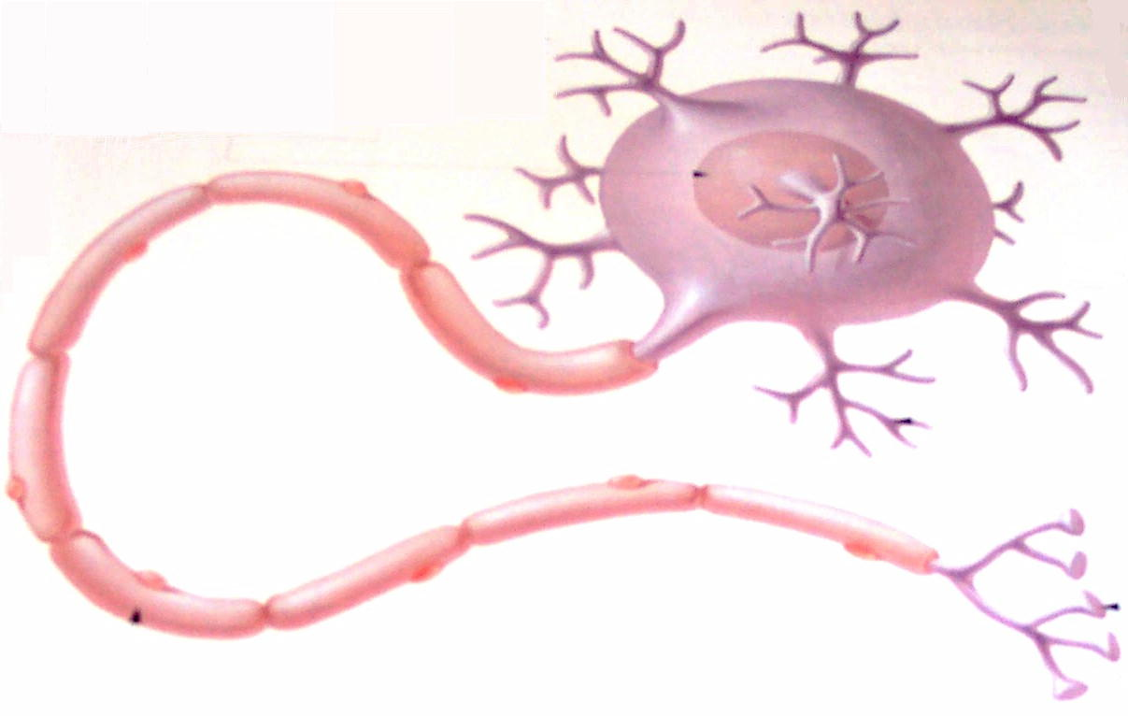
The Amazing Brain
A neuron with axon
and dendrites
                1 million, million brain cells
                50,000 connections can be made from each neuron
                Links (synapses)=learning
                PLASTICITY: experience & environment sculpt the brain - especially in infancy & adolescence
Notes:
From before birth, our brains start making connections and the more experiences we have within a safe environment, the more connections we make. The more we use these connections, the stronger they become.
The plasticity of the brain however means that it is always able to make connections. This will allow us to develop those skills required to survive in our own unique environments. If that environment is supportive and safe, we can relax and try new things and learn from these. If however, or home environment is stressful or dangerous in some way – physically or emotionally, we may develop skills for keeping ourselves safe. This will include learning not to trust anyone. The child growing up in a safe environment will believe that generally the world is safe and adults can be trusted. The child growing up in a neglectful or unsafe environment, will believe that the world is unsafe, adults can’t be trusted and they constantly need to scan their environment for threat.
However, it is possible to change neural connections: we CAN effect change, but once a habit has been established, even under ideal conditions, it is considered to take around 90 days of regular rehearsal to establish a new habit or routine. So even when people really want to change, it can be difficult, so how much more difficult is it to change behaviour when people don’t even know that they need to change.

Slide 16
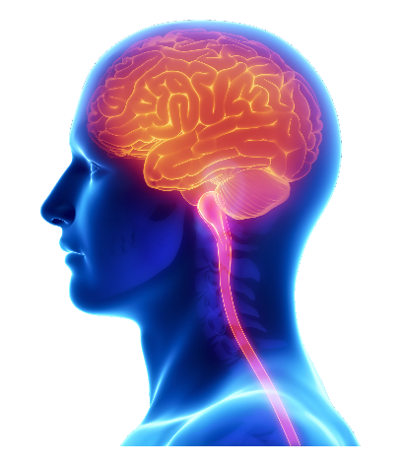
Brain science and the stress response made simple
Cortext – thinking, planning, inhibiting and learning
Limbic System
Attachment,
emotional and
behaviour
Primitive Brain
Motor and sensory input
Notes:
At birth, the cortex (the part of the brain where we do complex problem solving, thinking and organising) has few brain cells connected. The Limbic System (the feeling or emotional part of the brain) is waiting to make connections with the cortex, but already has connections with the primitive brain (the part of the brain that keeps us alive and makes sure all the basic functions work – heart beat, temperature regulation etc).
We are always looking to build relationships and make social connections, even from birth, because instinctively we know that the people around us will keep us safe. They will feed us, protect us, teach us as we grow etc and so we grow and develop in a way that builds connections with the environment into which we are born. Our first models are the adults around us, or parents and other family influences. But if they are not particularly skilled in building relationships, they may not necessarily be the best role models.
The most influential part of the brain early in our lives is the primitive brain, which is hard wired at birth and requires no language, thinking, organisation. We instinctively cry when we are hungry, because for the most part, when we do, we will get fed. We instinctively smile at faces to encourage them to smile back at us and make those early bonds with the adults who will care for us and keep us safe. We do this long before it becomes a conscious decision to do so. The primitive brain is also the part of the brain responsible for the stress response. The part that keeps us safe when we are in real danger. The part that makes us instinctively jump back on the pavement if we step out onto the road and a lorry is coming towards us. If we took time to process the danger, verbalise it and make a decision, it would be too late. So we need this part of the brain to work without thinking, but it sometimes can cause us problems too.

Slide 17
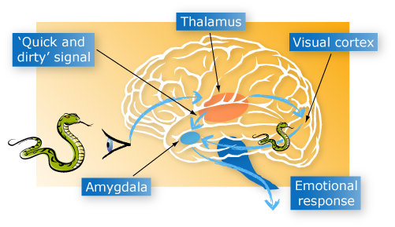
The Brain and Behaviour: anatomy of a hijack
FIGHT OR FLIGHT RESPONSE
Heart rate and blood pressure increase.
Large muscles prepare for action
Notes:
The fight or flight stress response always works in the same way.
All messages – sensory, verbal, visual, thought etc, come into the limbic system of the brain through the thalamus. This part of the brain labels the information as either positive or negative. This information then passes to the amygdala, which identifies it as safe or unsafe. If the information is considered unsafe, stress hormones flood the body before the prefrontal lobes (regulating executive function) can mediate this reaction.
The brain function ‘downshifts’ from cortex-based reasoning to emotional/instinctual (primitive brain) reactions. There is a fast response from the limbic system, sending a message to the primitive brain and the cortex at the same time, but there is a much slower response from the cortex and unless we already have practiced and understand what to do, or can rationalise our feelings quickly, the stress response will take over and effectively shut down the executive functioning of the cortex, reducing our ability to think rationally, make decisions or process language. In these situations, we might describe someone as having ‘a melt down’ or ‘losing it’ or ‘seeing red’. It is a normal reaction to a real or imagined fear and the best way to deal with it is to give time for the person to calm down, give then a safe space to sit or walk away, keep language to an absolute minimum and don’t give instructions or ask questions, as it is physically impossible to process these at this time.
It has been found that the amygdala in animals can respond to a perception in as little as twelve thousandths of a second and the amygdala is constantly scanning the environment for anything that may hurt us or things to fear. Our responses are individual because what we find threatening is individual. I might be afraid of wasps or dogs, but you might love them. I will have a stress response to them, but you wont.
Any strong emotion, anxiety, anger, joy, or betrayal trips off the amygdala and impairs the prefrontal cortex’s working memory. The power of emotions overwhelms rationality. That is why when we are emotionally upset or stressed we can’t think straight.
A good everyday analogy might be if we suddenly realise we should have been somewhere or done something important and have completely forgotten about it eg picked the kids up from school. When you get that sinking feeling in the pit of your stomach, that is usually a sign that the stress response is active.
In these moments, you are more likely to rush out the door and forget your car keys, get road rage because people are slowing you down, shout at or ignore people who try to reason with you or tell you to be calm, or it will be OK etc. we all experience hijacks, but mostly they are short lived, or we can take action to remove or relieve the stress, find a solution and calm ourselves.
But what if you cant fix the problem, or don’t even know what the problem is? What if you haven’t experienced these fears before and don’t know what the possible solution is, or that it will work out OK? What if you are constantly anxious and always feeling like this? That is the experience of some of our young people and right now, it is the situation that many adults are experiencing too.

Slide 18
This is NOT a choice!
Knowing what to do
Menu of strategies
Selecting what’s needed
Putting it into practice
2
Slower detailed appraisal
How big a deal is this?
Let’s calm down
And think what to do to solve it
3
Strong reaction = strong feelings
Emergency! – no time to think!
Fast emotional reaction
What’s going on?
What does it mean for me –
Fear? Anger? Happy? Bored?
1
Notes:
When it goes wrong, and we can’t handle the situation, what happens is that the brain has decided this is an emergency. It misses out step 2 and goes straight to action (who thinks in detail when a large elephant is rushing towards you – you just run!).
So we get actions that match the initial emotional reaction; what this means is we can work out from the strength of the action (shouting, running away, head on desk) what, and how strong, is the driving emotion – and we can address it
It is important to realise that from the person’s point of view, they are not really choosing what to do – the emotional reaction has taken over. It is rather like anti-skid systems on the car that temporarily take over the brakes and steering. And it can feel very uncomfortable.
It doesn’t matter if the feeling is reasonable (why despair over a worksheet?) – it is what their brain has decided is going on and we have to work with where they are.

Slide 19
What this means …
When we see inappropriate behaviour:
It is often an attempt to deal with a situation the brain has judged to be dangerous in some way and has selected actions that match that judgement.
We need to respond to the brain where it is:
  Be with the child
  ‘Listen’ to what lies behind the behaviour/language
  Do the emotional regulation for the young person
  Keep language to an absolute minimum
  Help them come back to thinking and choosing (this may take some time)
Notes:
This tells us what to do when things go wrong for a child or young person. In these situations, they cant think through the issues and come up with a plan. Neither are they able to access those parts of their brain that process language or problem solving and so we need to help them calm down in an area that is low stress, keep language to a minimum and help them feel and be, safe.
It can be helpful for children to have a better range of solutions they have practiced when faced with difficulties and this requires the connections to be string between the limbic system and the cortex. This requires the executive functioning of the brain to be developed through rehearsing and repeating useful strategies, most helpfully at tomes when the child is more settled and relaxed.
https://www.bing.com/videos/search?q=building+core+capabilities+for+life&&view=detail&mid=D17BA3B8EBCFFD200851D17BA3B8EBCFFD200851&&FORM=VRDGAR
This is a short video that provides a summary of what executive function is and how it can be developed.

Slide 20
Trauma-aware
This can happen to all of us
Children who have experienced trauma are more likely to be triggered into
  stronger feelings
  stronger reactions
  It might really feel like “life and death”
We need to learn the triggers
  And adjust so they can succeed
Notes:
Although this type of situation happens to us all on a regular basis, children who have experienced trauma will be more likely to have these triggers. Sometimes the triggers will be thoughts and memories, sensory triggers such as smells or sights and so we need to involved the children and young people themselves and get to know them, through the relationships we build, so that we can come alongside them and understand them.

Slide 21
Stress and trauma
Positive
Brief increases in heart rate, mild elevations in stress hormone levels
Tolerable
Serious, temporary stress response, buffered by supportive relationships
Toxic
Prolonged activation of stress response systems in the absence of protective relationships
Notes:
So stress is part of life, we all need positive stress, it helps us prepare and plan.
Positive stress response is a normal and essential part of healthy development, characterized by brief increases in heart rate and mild elevations in hormone levels. For example, the first day with a new caregiver or receiving an injected immunization.
Tolerable stress response activates the body’s alert systems to a greater degree as a result of more severe, longer-lasting difficulties, such as the loss of a loved one, a natural disaster, or a frightening injury. If the activation is time-limited and buffered by relationships with adults who help the child adapt, the brain and other organs recover from what might otherwise be damaging effects.
Toxic stress response, - more associated with adverse childhood experiences - can occur when a child experiences strong, frequent, and/or prolonged adversity—such as physical or emotional abuse, chronic neglect, caregiver substance abuse or mental illness, exposure to violence, and/or the accumulated burdens of family economic hardship—without adequate adult support. This kind of prolonged activation of the stress response systems can disrupt the development of brain architecture and other organ systems, and increase the risk for stress-related disease and cognitive impairment, well into the adult years.

Slide 22
Ready for a world with adversity
(adapted from traumasensitiveschools.org)
Learning
Trauma can undermine the development of learning skills and the capacity for creative play which can help children to cope. Leading to gaps in development and learning
Behaviour
Children may have developed coping mechanisms in an effort to feel safe and in control, which can be misunderstood. Impulsivity. Hyper-vigilance. Short attention. Higher reactivity to stressors Fight/flight/freeze
Relationships
Children who have experienced trauma may have difficulty forming relationships with adults and peers and need help to do this. Less effective ‘help seeking’.
Notes:
There will be children you work with on a daily basis, who are living in significant adverse circumstances or who have experienced trauma in their lives. This does directly impact on their day to day functioning, with different outcomes and reactions being seen by different children. However, it is helpful to look for the impact in three key areas:
Learning:
Learning rests on many underlying foundations, e.g. concentration, memory, organisation, language, trust etc. To learn effectively, children also need to be able to regulate their attention, emotions and behaviour.
Trauma can undermine the development of learning skills, e.g. ability to attend, interfere with memory and organisation, all of which we need to process information effectively. It can also interfere with the capacity for creative play, which is often one of the ways that children learn to cope with the difficulties of everyday life.
Behaviour:
Many children who have experienced trauma have developed behavioural coping mechanisms they use in an effort to feel safe and in control, - which may not be interpreted in that way, but instead as ‘socially unacceptable’ behaviours for the classroom - these can frustrate the adults and others around them if they are not understood, and often strengthen the child’s expectations of feeling unsafe, or a failure or unable to cope, so trying to understand where these are coming from and what might behind them is key.
Relationships:
Children who have experienced trauma can have difficulty forming trusting relationships with adults and peers. Preoccupied with their sense of safety, they can distrust adults and fellow pupils and may not also have had the opportunity to develop age appropriate social skills. They need support to build and develop positive interpersonal relationships.

Slide 23
What stress (fight, flight, freeze) looks like:
Flight | Fight | Freeze
Withdrawing Fleeing the classroom Skipping class Daydreaming Seeming to sleep Avoiding others Hiding or wandering Becoming disengaged | Acting out Behaving aggressively Acting silly Exhibiting defiance Arguing Screaming/yelling | Exhibiting numbness Refusing to answer Refusing to get needs met Giving a blank look Feeling unable to move or act
Notes:
Being aware of when a pupil may be experiencing stress and understanding that their problem solving skills are compromised at this time, can stop us from trying to reason with them too quickly – we understand that their stress response is just doing it’s job.
The interventions at these times are the same as we would use to support and co-regulate at any time:
Listen and understand what the behaviour is telling you.
Give the child time to calm down and allow them to come back to you/the group. Don’t try and have a conversation immediately, but wait for a quieter time and so this when no one else is around.
Acknowledge the situation and label the emotion for the child ‘It seems to me that you are feeling quite angry right now and I can understand that. What can I do to help.’
The child might find it easier to engage in a conversation if they are also doing another task alongside you – drawing, construction etc.
If the child is avoiding social contact build this gradually, having a purpose for short bursts of interaction with others and building slowly.
For new tasks, try and make a plan by asking ‘will this be hard or easy?’ If they think it will be hard, plan how you can support them. If it goes wrong, blame the plan, not the child and make another plan.

Slide 24
Trauma and the effects on behaviour
Experiencing trauma significantly increases the odds of scoring in the ‘clinical range’ for both externalising and internalising problems
Externalising
Internalising
  Aggressive behaviour
  Emotionally reactive behaviour
  Rule breaking behaviour
  Attention problems
  Social problems
  Anxious/depressed
  Somatic complaints
  Sleep problems
  Thought problems
  Withdrawn/depressed
  withdrawn
Notes:
It is therefore not difficult to see why children experiencing trauma are much more likely to also experience mental health issues and to either internalise or externalise their problems. Anything you can do to address their mental health and wellbeing will therefore also be beneficial.

Slide 25
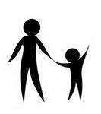
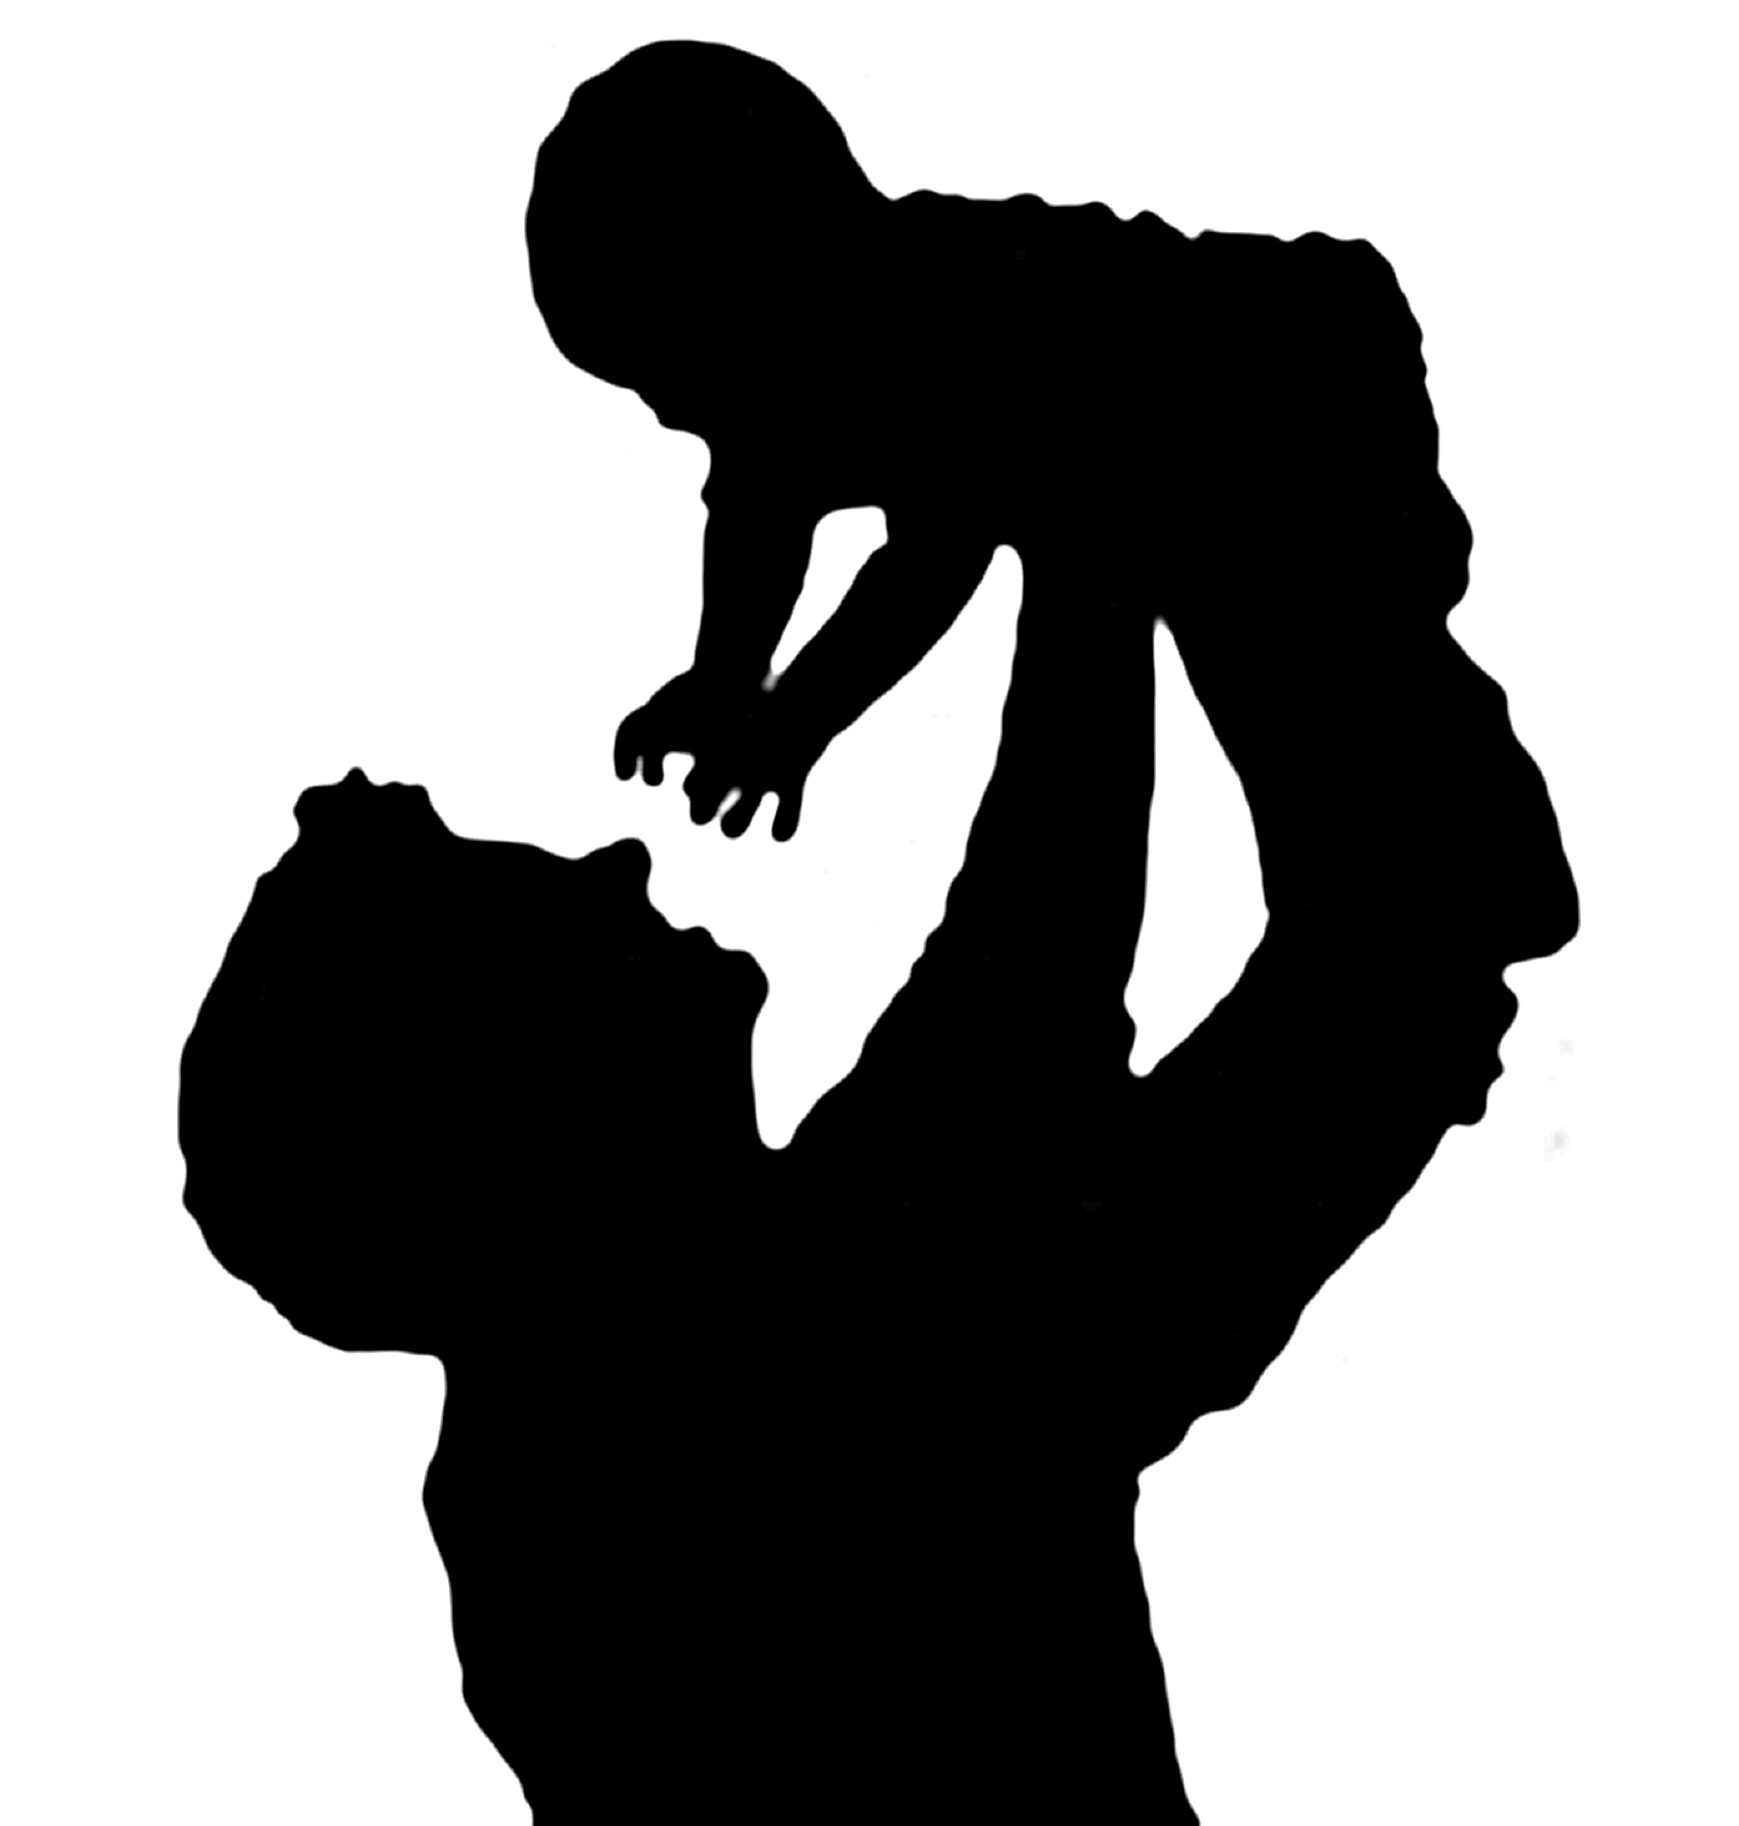
“just like there is a neurobiology of stress, there’s a neurobiology of trust, a neurobiology of connection and relationship”
(Pamela Cantor, CEO, Turnaround for Children)
Notes:
THIS IS REALLY IMPORTANT TO EMPHASISE
Relationships of trust are one of the most important antidotes to stress. Research has shown that the single most common factor for children who end up doing well despite adversity, has been at least one stable, committed relationship with a supportive parent, carer or other adult.
These relationships provide a personalised response, scaffolding and protection from developmental disruption.
They also help children to develop self-regulation skills, which help them to better manage stress and adapt to changing circumstances.
In essence they can help to build and develop a child’s resilience.

Slide 26
Resilience is…..
‘A set of qualities that helps a person to withstand many of the negative effects of adversity. Bearing in mind what has happened to them, a resilient child does better than he or she ought to’ (Gilligan 2001)
‘Normal development under difficult circumstances’ Fonachy 1994
https://www.youtube.com/watch?v=1r8hj72bfGo
Notes:
The antidote for coping with potentially shaming situations and negative experiences or set backs, is to develop resilience. The more self confident and resilient we are, the better able we are to have the conversations with others about how we feel, how they have contributed to these feelings and how we can rebuild and repair relationships.
You cant give someone resilience, but you can establish the conditions that help them become resilient over time.
Many of the children who ‘act out’, may not yet have learned the skills that will support their resilience. They haven’t yet learned enough language to explain and express how they feel, nor have they practiced trying out solutions often enough to have the confidence that they can cope with set backs or new or frightening situations.
Watch the Youtube video in the link. It comes from the Harvard group and is a short film on the mix between genetic disposition and life events that support or diminish resilience. Right click on the link. Choose ‘open hyperlink’ and it will start automatically.

Slide 27
3 Features of Resilient People
Resilient people know that suffering is part of human existence. They don’t ask ‘why me?’
Resilient people are good at choosing where to put their attention. They focus on the things they can change and let go of the things they cant.
Resilient people ask themselves, ‘Is what I am thinking and doing helpful or harmful?’
Resilience isn’t a fixed trait that some people have and some don’t. It can be developed and enhanced.
Notes:
Resilient people can accept that bad things happen to good people. They accept the random nature of suffering and find ways to cope in really challenging situations. Children may naturally feel that difficulties are targeted towards them and it will be helpful for them to see the bigger picture and be supported to put things in perspective. As adults, we need to also accept that things are not personal. Generally a child who is providing challenge is reacting to difficulties in their lives and not specifically aiming any negativity at us personally.
Humans are good at looking at negativity and threat. This is helpful for survival but resilient people can also tune into the good. Some children will be predisposed to looking for threat and negativity due to earlier life experiences (as will some adults). It will be helpful to focus on 3 good things that happen each day. Give children the permission to feel thankful and to intentionally and deliberately look at what is good in their world. Recording this on a poster or in a diary will make this real and provide a visual display to balance the negativity.
If behaviours are making a situation worse, children may need to be supported to consider whether these behaviours are making the situation for them better or worse. If things are made worse by an activity, can they be supported to reduce their involvement in these activities or to avoid them altogether and do something different. Children may need help to consider an alternative, more helpful activity to fill the gap. All behaviour serves a purpose and so we will need to understand the function of the behaviour, so that we can swap it out for another behaviour that may be more helpful, but fulfils the same function. Eg being the clown and having people laugh at you might give much looked for attention. Can they show off their skills of music or art to get a similar level of attention?
Resilience isn’t a fixed trait. Children (and adults) can learn some of these strategies. They wont come naturally to everyone and they might not work immediately. Keep trying. Dealing with stressors wont naturally make children more resilient. It may make them less able to cope, more vulnerable and feeling overwhelmed. Children do however need to develop greater levels of resilience to cope where stressors can not be removed. Having an understanding of resilience, how it works and how it can be developed may make our focus more effective.

Slide 28
Building Your Self Esteem and Resilience
Promotes responsibility
Teaches social skills
Provides a nurturing role model
Provides predictable routines
Provides structure and security
Sense of belonging
Social Competencies
Secure Base
Sense of self
Sense of personal power
Sense of belonging
Avoids shame
Is a positive model
Values own well-being
Provides appropriate
curriculum
Allows repetition
and consolidation
Experience success
Positive
Values
Education/
Learning
Encourages talents and interests
Provides opportunities to ‘try’
Ensures participation Values and validated
Thinks young. Takes time
Talents and Interests
Friendships
Notes:
In terms of those environmental factors, some aspects have been shown to be helpful to consider, in giving a child the opportunity to develop resilience. These Domains of Resilience provide a framework to consider that can helpfully guide us to what areas may helpful in supporting a child.
Its about that balance shown in the video. If everyone is developing leisure interests, but not addressing other areas and issues, the child will not develop the range of skills required to promote resilience.
As resilience builds, so too does self esteem, as this is core to how we feel about ourselves and our competencies and how we fit with our peer group. Self esteem is made up of 3 components – sense of self, sense of belonging and a sense of personal power, and all three aspects need to be developed in order for a stable self esteem to be established. One aspect is not more important than the other, but they are dependent on each other.
However this isn’t a constant. Self esteem is situation dependent. We can feel a strong sense of belonging in one context, feel confident in our skills and believe in ourselves, but not in another. This is why sometimes children and young people can feel safe and secure engaging n one activity, but feel they are out on a limb in a different situation

Slide 29
Protective Environment
* Good school experience
* One supportive adult
* Special help addressing emotional/behavioural needs
* Community networks
* Leisure activities
* Talents and interests
Vulnerable Child
Protective Environment
Resilient Child
Protective Environment
Vulnerability
* Poor attachment
* Minority status
* Young age
* Disability
* History of abuse
* Innate characteristics in child/challenge
* A loner/isolation
* Institutional care
* Early childhood trauma
* Communication differences
* Inconsistent/neglectful care
Resilience
* Good attachment
* Good self esteem
* Sociability
* Good level of ability
* Flexible temperament
* Problem solving skills
* Positive parenting
* Attractive
Vulnerable Child
High Adversity
Resilient Child
High Adversity
Adversity
* Life events/serious crises
* Illness loss/bereavement
* Separation/family breakdown
* Domestic violence
* Asylum seeking status
* Serious parental difficulties eg drug abuse/alcohol misuse
* Parental mental illness
Notes:
When we look at resilience and the protective factors around in our environments we are looking at the same types of issues.
The environments we live and work in provide protective or adverse features which can compensate for or add to a lack of resilience at any point in time.
In addition, some people are resilient and therefore even in adversity can cope and grow, whereas others will crumble. We can enhance the possible outcomes for children by strengthening the protective factors and enhancing their levels of resilience.
We do however need to take account of variations relating to age, numbers of adversities etc, which will complicate this process.

Slide 30
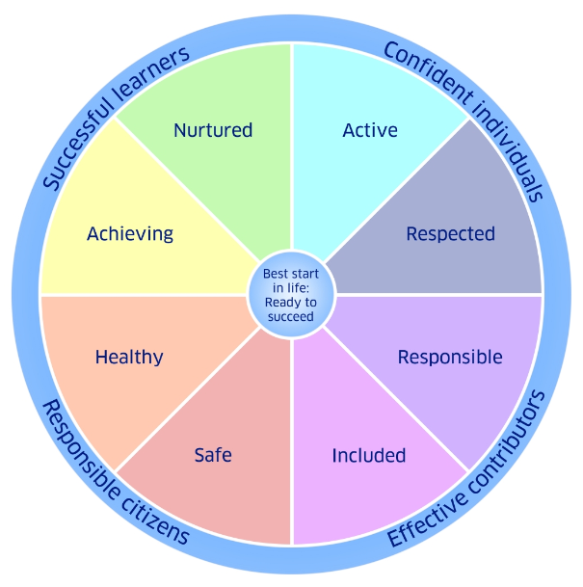
Buffering – anything that helps build wellbeing
Notes:
Let’s not over complicate things though. Remember, what we are trying to do is to understand why a child may not have their wellbeing needs met and how we might buffer that adversity and support their wellbeing. This is a core component of the educational curriculum in Scottish schools.
We’ve talked a lot about feeling unsafe and the stress response that comes as a result of this. Lots of things can make us feel unsafe – physically, emotionally, socially or academically. This is key, as fear and anxiety generally sits below the most challenging behaviour of both adults and children.

