Slide 1


Nurturing Principles
Supporting Nurture
in School Hubs
Understanding and using the Nurture Principles
Notes:
Click, ‘slide show’ tab and then ‘from beginning’. You will be able to pause to explore resources.

Slide 2
Unusual Times
We are in unusual times right now, but must ensure that staff who continue to work with children and young people follow the agreed guidance and policies available within Highland Council.
This short training module is a summary of some of the key messages provided to staff who work with children and young people.
Further information on any of the information contained in this module can be accessed from the Education Scotland website here

Slide 3
Outcomes
Explore each of the six Nurturing Principles
Establish how each of the Nurturing Principles can be applied in a group setting

Slide 4
“Emotional wellbeing, social competence and cognitive abilities together are the bricks and mortar that comprise the foundation of human development.”
The Developing Child – Harvard University

Slide 5
The 6 Nurturing Principles
Learning is understood developmentally
Nurture is important for Wellbeing
Language is a vital means of communication
All behaviour is communication
Transition are important in children’s lives
Environment offers a Safe Base

Slide 6
What does this principle mean?
Learning is understood developmentally
The response to the child is ‘as they are’, underpinned by a non-judgemental and accepting attitude
Staff responding to children at their emotional/developmental level, not their chronological age.
Independence develops through dependence.

Slide 7
Reflection
Learning is understood developmentally
“Do not expect to see a behaviour you are not prepared to teach.”
Marg Thorsborne (2015)
Key Areas to consider:
What can we expect developmentally?
How do we adapt our expectations?
What is the role of the adult in supporting development and mediating learning experiences?

Slide 8
Resources to explore theories
Learning is understood developmentally
Social and Emotional Development
  www2.ed.gov/about/inits/ed/earlylearning/talk-read-sing/feelings-milestones.pdf
Stages of Play and Stages of Social Play
  www.autismtoolbox.co.uk/play-and-leisure
Moral Development (Film 9:52)
  www.khanacademy.org/test-prep/mcat/individuals-and-society/self-identity/v/Kohlberg-moral-development

Slide 9
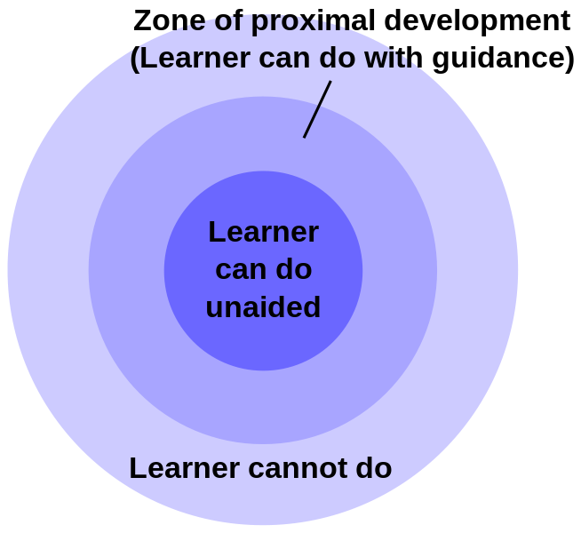
Resources to explore theories
Learning is understood developmentally
Vygotsky - Mediation of Learning
Zone of proximal development
A child or young person can
perform at a greater level when
mediation is provided by an adult
Consider both what a child or young person can do unaided and with your support
Social interaction is key
Vygotsky, 1978

Slide 10
What can I do?
Learning is understood developmentally
Think young - child’s social and emotional age, not chronological
Avoid “should” assumptions
Know the background of a child and consider how it has impacted on their development at this time
Think about how you assess children – assess holistically (include language, social and emotional skills – consider a baseline assessment)
Use “Second chance learning” through attachment figures – key adult to mediate learning – quality of interactions is key
Think about what elements of social development may not have been ‘caught’ and now need to be taught
Model the behaviours you expect
Consider ‘learning behaviours’ and what they are telling you about the child’s development

Slide 11
What does this principle mean?
Environment offers a Safe Base
The group is organised around a structured day with predictable routines. Great attention is paid to detail; the adults are reliable and consistent in their approach to the children.
Importance of firm, clear boundaries and adults and children working together supportively.

Slide 12
Reflection
Environment offers a Safe Base
Key Areas to consider:
What is the role of the adult in providing a safe base in school?
What does the physical environment and resources look like?
How do we offer structure and boundaries to help pupils feel safe?
‘A secure connection means that children can explore their world knowing that they can come back to their emotional and relational base camp when they do not feel safe or are uncertain.’
- Australian Childhood Foundation

Slide 13
Resources to explore theories
Environment offers a Safe Base
Sense of belonging and valued
  https://www.mentallyhealthyschools.org.uk/risks-and-protective-factors/school-based-risk-factors/relationships-and-belonging/
Safety and executive function
  Stress response impact working memory and cognitive flexibility
  Language
Social engagement to re-establish safety
  https://beaconhouse.org.uk/wp-content/uploads/2019/09/The-Polyvagal-Theory.pdf
Sensory integration

Slide 14
Resources to explore theories
Environment offers a Safe Base
Containment is where a person receives and understands the emotional communication of an other without being overwhelmed by it and communicates this back to the person
Projective Identification
https://beaconhouse.org.uk/wp-content/uploads/2019/09/Projective-Identification.jpg

Slide 15
What can I do?
Environment offers a Safe Base
Create a controlled emotional atmosphere
Develop consistency - over time and between adults
Set clear parameters and boundaries – create an ‘authoritative climate’
Demonstrate that it is okay to make mistakes / to fail
Provide different options for praise and reinforcement
Learn about de-escalation and practice it in the class
Offer a way out / a way back
Stay with a pupil who is distressed to help regulate their emotions
Take into account where a young person is on arousal continuum
Practice ‘availability’
Provide additional structure and supervision when needed
Practice positive beginnings and positive endings in your class

Slide 16
What does this principle mean?
Nurture is important for Wellbeing
Staff listening and responding to children in ways that shows they are valued and thought about or kept in mind.
In a nurture provision ‘everything is verbalised’ with an emphasis on the adults engaging with the children in reciprocal shared activities e.g. play, meals, reading, talking about events and feelings.
Children respond to being valued and thought about as individuals, so in practice this involves noticing and praising small achievements; ‘nothing is hurried in a nurture provision’

Slide 17
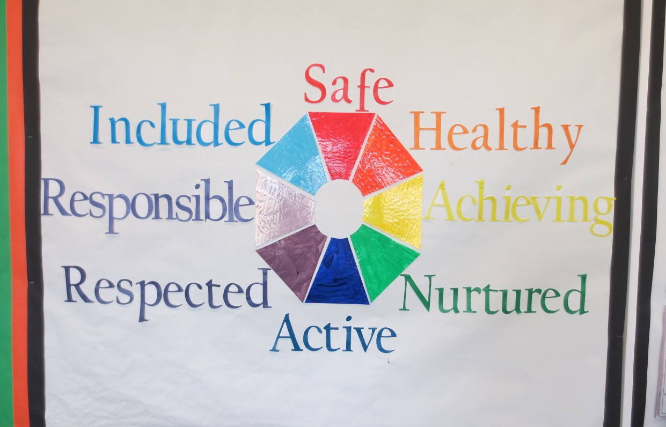
Reflection
Nurture is important for Wellbeing
Key Areas to consider:
How does this Nurture Principle fit with the GIRFEC agenda?
What do children need from us to do and be their best?
How can we promote wellbeing and self-esteem?
What is the importance of resilience in promoting wellbeing?

Slide 18
Resources to explore theories
Nurture is important for Wellbeing
Resilience can be promoted and learned. These can be organised into:
External supports that promote resilience (I have…)
Inner strengths that can be developed to deal with adversity (I am…)
Interpersonal skills to deal with it (I can…)
Grotberg (2003)
Building Resilience
https://www.youtube.com/watch?v=1r8hj72bfGo&t=29s
https://beaconhouse.org.uk/wp-content/uploads/2019/09/Building-Resilience-Training-Aid-compressed.pdf

Slide 19
Building Your Self Esteem and Resilience
Nurture is important for Wellbeing
Social Competencies
Secure Base
Sense of self
Sense of personal power
Sense of belonging
Positive
Values
Education/
Learning
Talents and Interests
Friendships

Slide 20
Nurture is important for Wellbeing
Resources to explore theories
SELF ACTUALISATION
SOCIAL & EMOTIONAL COMPETENCE
SELF ESTEEM
LOVE & BELONGING
SAFETY & SECURITY
PHYSIOLOGY:
food, water, shelter, clothing
Notes:
20

Slide 21
What can I do?
Nurture is important for Wellbeing
Provide opportunities for young people to succeed at tasks and feedback how they achieved this
Identify and share personal achievements of young people, e.g. Book of Success
Enhance close relationships with children so you can challenge negative beliefs about them in a supportive, empathic way
Help develop understanding of children’s rights and responsibility
Provide opportunities to build resilience – link to a resilience framework
Consider how you can diminish risk factors whilst increasing protective factors – link to My World Triangle

Slide 22
What does this principle mean?
Language is a vital means of communication
Language is more than a skill to be learnt, it is a way of putting feelings into words.
Some children ‘act out’ their feelings as they lack the vocabulary to ‘name’ how they feel. Words are used instead of actions to express feelings and opportunities are created for extended conversations or encouraging imaginative play to understand the feelings of others.
In nurture provisions the informal opportunities for talking and sharing, e.g. welcoming the children into the group or having breakfast together are as important as the more formal lessons teaching language skills.

Slide 23
Reflection
Language is a vital means of communication
Key Areas to consider:
How well do you know about children’s language development? Vocabulary gap?
How can we support children to express their feelings through language?
How can we attune/attend to children’s verbal and non-verbal communication?
How aware are we of our own non-verbal communication?
The limits of my language means the limits of my world.
Ludwig Wittgenstein

Slide 24
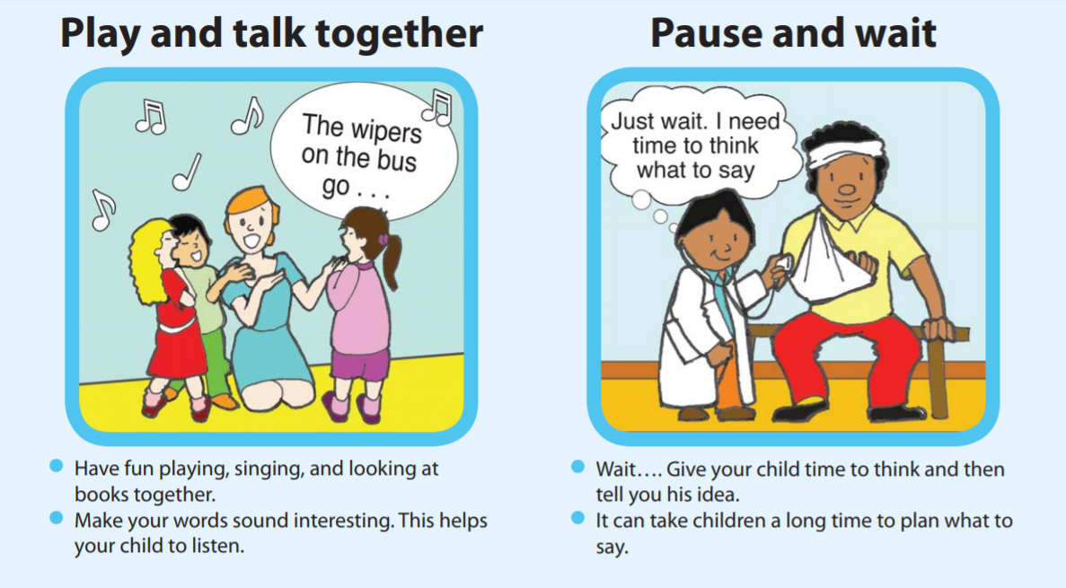
Resources to explore theories
Language is a vital means of communication
Highland Council Words-up
  https://highlandliteracy.com/words-up-key-messages/
Learning new words
Language Development
  https://www.thecommunicationtrust.org.uk/media/363847/tct_univspeak_0-5.pdf
Attuned relationship
  https://beaconhouse.org.uk/wp-content/uploads/2019/09/The-Three-Rs.pdf

Slide 25
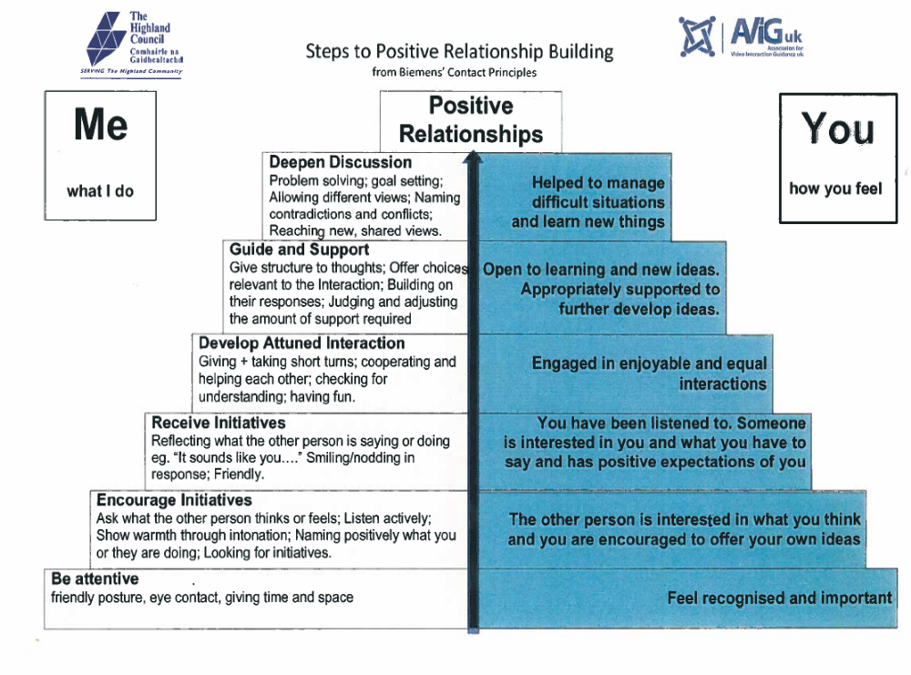

Slide 26
What can I do?
Language is a vital means of communication
Understand what language is consistent with de-escalation
Understand role of non-verbal language, and the need to match
Know the difference between tight, coercive and loose language
Recognise the relationships between, verbal, non-verbal, and tone, volume and tempo
Name and model desired behaviours
Use developmentally appropriate language
Develop dialogue not monologue
Maintain these messages in all communication
You belong here
You are welcome here
I like you
You are safe here
I will help you understand
Your feelings are okay with me
You can explore and learn
You can work with me on this problem that is getting in the way right now
I was/will be thinking about you, and keeping you in mind

Slide 27
What does this principle mean?
All behaviour is communication
This principle underlies the adult response to the children’s distressed behaviour which might be described by some as challenging. “Given what I know about this child and their development, what is this child trying to tell me?” Understanding what a child is communicating through behaviour helps staff to respond in a firm but non-punitive way by not being provoked or discouraged. If the child can sense that their feelings are understood this can help to diffuse the situation. The adult makes the link between the external and internal worlds of the child.
Children and adults use behaviour to communicate how they are feeling, sometimes when they don’t have an opportunity to verbalise what they are saying or sometimes when they can’t find the internal resources to translate their feelings into language.

Slide 28
Reflection
All behaviour is communication
Key Areas to consider:
How do school policies, practices and structures support understanding of behaviour?
How do relationships in schools impact on children’s behaviour?
What strategies/approaches do we use to support relationships and behaviour and are they congruent with a nurturing approach?
How does ‘shame’ impact on behaviour?
How do we use de-escalation practices to support behaviour?
‘Conflicts are endemic in school life: that is not necessarily a problem – it is the way that we handle them that matters.’
Watkins and Wagner, 2000

Slide 29
Resources to explore theories
All behaviour is communication
Some common responses
Escalate situation – ‘Don’t give me excuses’ ‘Don’t you speak to me like that’
Hostility – ‘You should be ashamed of yourself’
Passive – ‘Why did you do that?’
Preferred responses
Give a statement of what you want –’I want you to return to your table’
Stick to your statement – repeating if necessary
Deflect the other person’s responses possibly by recognising their view – ‘I’ve heard your reason for leaving your table – to speak to your friend, but I’d like you to return to your table’
If needed, have a restorative conversation
Theory of mind: www.autismtoolbox.co.uk/cognitive-theories

Slide 30
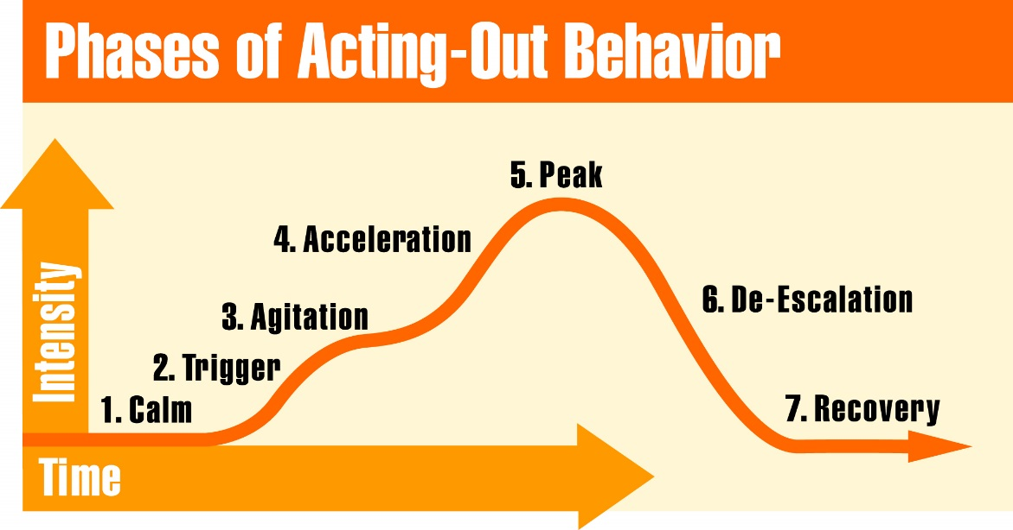
Resources to explore theories
All behaviour is communication
De-escalation techniques go against our natural fight-or-flight reflexes. Remaining calm and professionally detached is not natural and therefore it is a skill that will need to be practised. We need to retrain ourselves to respond in a different way when a challenging situation occurs.

Slide 31
What can I do?
All behaviour is communication
Be in tune with your own emotions and their impact - practice responding assertively
Consider what a child or young person’s behaviour is communicating – link with assessment – record in plan
Develop a consistent and collaborative team approach to support problem solving – reflect this in relationships policy
Consider de-escalation training and practice your responses to conflict (think about non-verbal messages)
Practice restorative conversations after difficulties when pupil is calm
Notes:
How do we work to ensure our body language is calm and in tune with our language?
Remembering this is something many young people will hone in on
Ensure our self awareness of this?
How much of communication is non-verbal ?
What language gets used that conveys the opposite message?

Slide 32
What does this principle mean?
Transition are important in children’s lives
Transitions typically involve the ending of one task and the beginning of another, it involves a shift between two events. When planned we experience anticipation and when unplanned we can experience surprise.
Staff who acknowledge the feelings aroused by transitions and who understand that even small changes in routine (e.g. a visitor, a supply teacher, going to lunch) can be overwhelming and unsettling to some children.
Transition can be a developmental pathway
Notes:
Often staff will have a routine at lunch time, maybe they eat in the staff room, an implicit understanding of whose seat is whose. Reflect on how you feel when a visitor takes your seat?
Transition as a developmental pathway – this means it can change the developmental trajectory. Resilience literature has highlighted transition as a developmental pathway-meaning it can be a point that decides where a child’s life takes one trajectory or another, and is there are risks around for a person and it goes badly push further down a negative pathways, and if it goes well the opposite

Slide 33

Reflection
Transition are important in children’s lives
Key Areas to consider:
What are ‘Transitions’?
Why might transitions be so significant?
Why might transitions be so difficult for some young people?
What transitions have we faced?
How did we feel?
What helped us?

Slide 34
Resources to explore theories
Transition are important in children’s lives
Change of routine, losses and separation
  https://beaconhouse.org.uk/wp-content/uploads/2019/09/Supporting-Transitions-2.pdf

Slide 35
What can I do?
Transition are important in children’s lives
  Clear class welcome routines
  Personal greetings
  Children are prepared for changes in routine; clear procedures for this
  Simple changes are introduced to routine and environment gradually
  Visual timetables/timers
  Creative ideas: transitional objects/signs
  Opportunities to touch base with key staff early in the day
  Ensure enough time in day for transitions
  Get to know background so can support transitions
Notes:
There should be routines which are simple and easily understood by staff, parents and children. Transition should be slow moving and have a clear time structure so establishing a secure base.
Any changes to routine such as teacher absence and visitors should be prepared for where possible. And there should be clear procedures in the your establishment for this.
Simple changes in routine and environment are prepared for in detail so as to accustom children to change but in a supporting and affirming manner.
Some children may be unable to sustain achievements due to a variety of reasons however this should not detract from their initial achievement. Also during times of stress, most children (and adults) need additional support. Therefore links with parents are vital to ensure that any stressors can be accounted for and plans of action devised.
Staff can make use of transitional objects to help a child separate. However this should be used with clear boundaries for the child.

Slide 36
Nurturing Principles – Activity
Nurturing Principle | Examples from my current practice | What I will try:
Children’s learning is understood developmentally
The environment offers a safe base
Language is a vital means of communication
Nurture is important for the development of wellbeing
All Behaviour is Communication
Transitions are important in children’s lives
Notes:
See handout titled Nurturing Principles Practical Strategies.

Slide 37
Acknowledgments
Education Scotland – Whole School Nurturing Approaches – module 4
Norfolk Nurture Hub
Beacon House
Highland Council – Promoting Positive Relationships 2019/2020

