Slide 1


Awareness and understanding of how change, loss and bereavement can impact children and young people.
Notes:
Welcome to the Change, loss and bereavement training package. There is audio to listen to for some slides but there are also scripts. On slides with audio you will see a ‘sound sign’ to click on at the top right hand corner of the slides.
Please remember to look after yourself while going through this training. It might be an idea to break it up into smaller chunks – some of the information can bring up some of our own experiences and it is normal to feel emotional.
We all experience change and loss on a regular basis. Most of the time we adapt and manage but at the moment we are experiencing some of the biggest changes on our day to day lives that we have ever experienced. Changes to our routines, our social contacts, the choices we can make about the things we enjoy doing. All of these changes mean that we are all experiencing feeling of loss due to us not being able to see some family members, friends, work colleagues. For us as adults it can be hard to make sense of these changes but for children and young people it might be hard.
It’s important to remember that for some of the young people you will be supporting through this challenging time they might have already experienced a lot of change and loss as well as bereavements. This might mean that they could be struggling already and these further changes could be even harder for them.

Slide 2
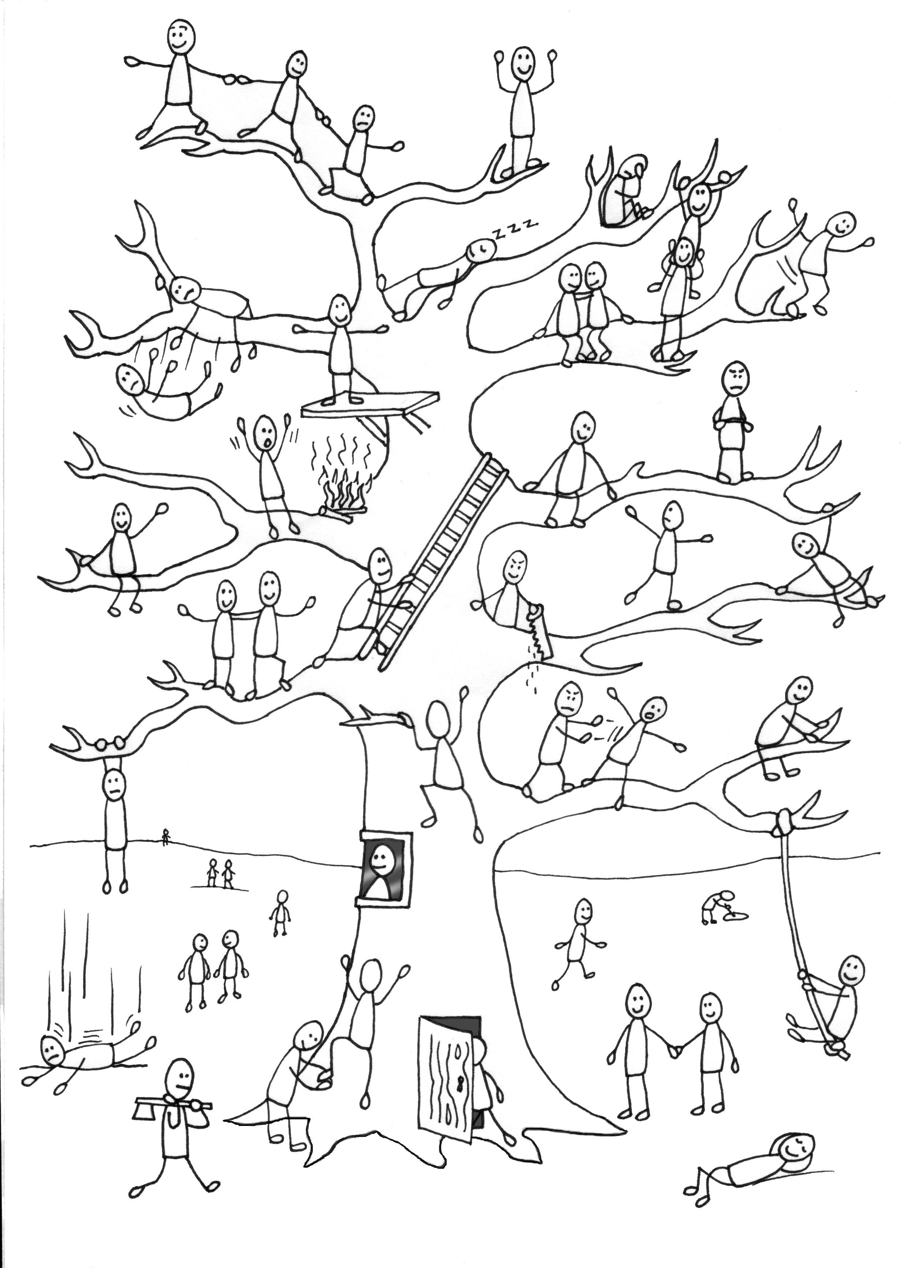
Activity
Check in – blob tree
How am I feeling today and why?
Notes:
When we are supporting the wellbeing of children and young people it is important to also think about our own. Using an activity like this is good for us to stop and think about how we are feeling but it is also an activity that we can use with young people. What character do you think depicts how you are feeling today?

Slide 3

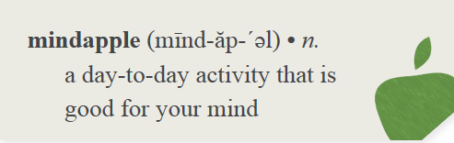
Mindapples
1.
2.
3.
4.
5.
Notes:
To continue with thinking about looking after our own wellbeing it is important that we think about our self care. It is recommended that to look after our physical health we eat fruit and vegetables. Mindapples remind us of the importance of looking after our emotional wellbeing whether that is how we manage our days at work or at home. Some of the things we might think about are that we make sure that we stop for lunch and finishing on time at the end of the day. We might also enjoy exercise, reading a book, meeting up with friends and family or watching a movie. We all have different interests and activities that we enjoy that ‘nourish’ us. Sometimes we get quite busy and can forget to do a lot of these things. Think about what you do for self care. When we are supporting young people who are struggling and distressed at times we need to also think about ourselves. This is also a good activity to use with young people to think about things they do to look after their wellbeing – sometimes we forget what we do and how we can link back into activities that we enjoy. Write down your 5 mindapples and put it somewhere to remind you of things that will help.

Slide 4
What is Loss?
What is Change?
Oxford Dictionary
(noun)
An act or process through which something becomes different
Oxford Dictionary
Fact or process of losing something or someone
mislaying, misplacement, dropping, forgetting, overlooking
death, demise, passing, passing away, deprivation, disappearance, impoverishment
Notes:
When we talk about loss, we talk about it in its widest sense.

Slide 5
Examples of loss
Bereavement
Suicide
Families affected by imprisonment
Care Experienced Young People (multiple losses)
Friendships
Moving Home
Financial
Parents Separation / Divorce
Transitions
Loss of a pet
Change of role/responsibility
Beliefs
Health
Siblings moving away
Change of teacher
What could have been
Notes:
Here are some identified losses, this is not an exhaustive list. Please note that while we assume that loss is always associated with negative feelings some of these could be changes that lead to loss but have more positive outcomes. For example – parents separating might be a positive change as life has become really difficult with them arguing at home all the time. Them separating might be hard but it might lead to happier times with both parents. Getting a new job can often be a positive new start for people but think about all the change that happens – new colleagues, new responsibilities, possibly new working hours etc We sometimes experience grief like feelings for some of these losses the next slide will help you to think about that a bit more.
What could have been is an interesting one – sometimes we have expectations of how our lives might go or things that might happen and there can be a sense of loss for things that could have been!
Stop and think for a minute the changes you have experienced in your own life, the feelings that you can remember experiencing and what helped you at the time – the next slide will help you think about this a bit more.

Slide 6
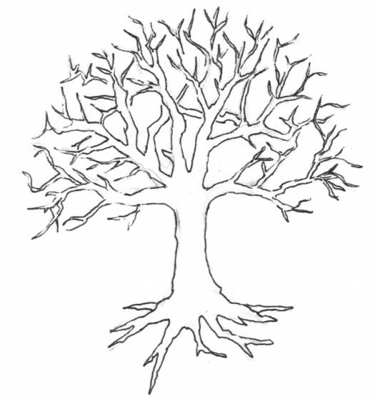
Respond Tree
2. At the top of your tree add the way you would describe who you are now.
Think about the following:
Your likes
Your dislikes
Your fears
Your skills
Your personality
How you feel about yourself
How you feel about your life
How you cope with difficulties
1. At the roots of your tree add the things that have influenced your growth.
Think about the following:
Where were you born
Your family
Your religion or beliefs
Set backs
Losses
Major events in your life
Achievements
Your Education
Your Career
Notes:
Think about what might be at your roots and then at the top of your tree. This helps us to think about ourselves and some of the change and loss that we will have experienced. It also allows you to think about how you coped and who or what helped you at the time. Sometimes things like moving home, moving schools are common experiences that we might have.
Then think about some of the young people you might work with and what would be at their roots. What do you see at the top of their tree – think about some of the behaviours you might observe.

Slide 7
Examples of current losses related to Covid 19
Routine
School
Changes in parents working patterns
Seeing friends
Seeing family
Doing activities
Not sitting exams
Going to the park
Space in the house
Possible illness for self or others
Possible bereavements
Unknown timeframes
Notes:
If we think about the current situation and the amount of change that has happened for all of us over the past few weeks. As we don’t know how long this will be for it is hard to think about what our normal is. Getting used to new routines will have been hard, over the past few weeks. School and the routine it provides will be a loss as well as this is where you see your friends every day and also your teacher and all the other staff who will be trusted adults especially if some of the adults that they live with aren’t able to be at times. Parents might have a change in work routines – it might be good if they are working at home but others will be working on the frontline and working longer hours. Not seeing friends and extended family will be hard. There might also be worries about what if I or others get ill – some of the information in the media can make us all worry. From the media we are hearing about the daily numbers of deaths due to the virus so it is only natural that for all of us this is a huge worry.

Slide 8

Notes:
http://www.healthscotland.scot/population-groups/children/adverse-childhood-experiences#Animation
https://youtu.be/VMpIi-4CZK0 – open on chrome!!
You might be aware of the ACES (adverse childhood experiences) study. Adverse childhood experiences can impact on physical and emotional wellbeing later in life. In the original study bereavement was not on the list but we know that the impact of loss and the changes that happen after someone dies that it can have a huge impact. When you are watching the video think about all the change and loss that each of the events would have for a child or young person.

Slide 9
Activity – examples of loss
Lose your mobile phone
Elderly grandmother passes away after a period of illness
Dog runs away
Car gets stolen
Engagement ring is lost at a beach
Split up from partner
Lose your keys
Parents sell your childhood home
Laptop stolen with personal information on it
Nephew dies in a car accident
Child leaves home
A colleague dies suddenly
Notes:
All of these are examples of loss. As you click through them think about how each of these might impact on you and how you would feel. Teenagers might get really upset if they were to lose their mobile phone whereas others might be glad to have some peace from it.
Elderly grandmother dies – sometimes you might feel relieved if it’s after a log period of illness and they are no longer suffering, if they lived on the other side of the world and there wasn’t a regular relationship – you might feel sad but it might not cause you distress.
Dog runs away –
Car gets stolen
Engagement ring is lost at the beach
Split up from partner
Go through the others and think about how they might impact on you.
We all respond differently to some things, have different relationships with objects and people. We are all unique and therefore it’s important to understand that our feelings won’t be the same as others – we can’t assume that a child will be really distressed by their grandmother dying but we should ask them how they are and find out more about this.

Slide 10
Highland Lifestyle Survey
We asked pupils in P7, S2 and S4 the following questions:
Have you experienced the death of a close family member?
Have you been affected by the death of someone that isn’t a family member?
If you answered yes to either of the above questions, were you able to seek support from someone afterwards? (select your first point of support)
Notes:
The Highland Lifestyle survey asks pupils in P7, S2 and S4 to answer questions about themselves and their lifestyle. It is done every 2 years. Above and over the next few slides are the results from the lifestyle survey 2019.

Slide 11
Pupil Responses:
Have you experienced the death of a close family member?
67.6% of pupils across all cohorts had experienced the death of a close family member (2123 pupils).
Of those that have lost someone :
23.3% had done so in the last year,
39.6% between 1 and 5 years ago and
18.6% more than 5 years ago.
Notes:
Above are the results from the lifestyle survey 2019.
P7, S2, S4 – carried out once every two years.
2017 Result: 67.1% (1990 pupils)

Slide 12
Pupil Responses:
Have you been affected by the death of someone that isn’t a family member?
42% of pupils across all cohorts had experienced the death of someone who wasn’t a family member (1263 pupils).
Notes:
Above are the results from the lifestyle survey 2019.
P7, S2, S4 – carried out once every two years.
2017 Result: 40.8%

Slide 13
Pupil Responses:
If you answered yes to either of the above questions, were you able to seek support from someone afterwards? (select your first point of support)
The overwhelming majority of pupils that had experienced bereavement (87.6%), were able to seek support from their family and friends.
Family | 72.82%
Friends | 14.77%
Guidance Teacher | 1.36%
Children's Service Worker | 0.98%
School Nurse | 0.16%
GP | 0.16%
Church Minister | 1.19%
Other (please specify) | 8.56%
Notes:
Above are the results from the lifestyle survey 2019.
P7, S2, S4 – carried out once every two years.
2017 results: 89.6% sought support from family and friends.
2019 results show an increase in those speaking to Guidance/CSW/Church and a decrease in family.

Slide 14
Notes:
The next few slides will be looking at models of grief. Some of these models will help us to understand people’s responses to grief but it is important to remember that we all grieve in different ways. We used to think about grief responses in quite a linear way but this model helps us to think about it differently.
In the mid-90s, Margaret Stroebe and Henk Schut came up with a model of grief called the dual process model. This bereavement theory suggests that grief operates in two main ways and people switch back and forth between them as they grieve.
You may have heard people talk about how grief has to be ‘worked through’ or ‘faced head on’. Stroebe and Schut do not believe that this is true. They suggest that sometimes ignoring your emotions, or distracting yourself from your grief, is a natural way of coping with grief.
This theory of grief describes two different ways of behaving: loss-oriented and restoration-oriented. As you grieve, you will switch, or ‘oscillate’, between these two different modes of being. This is why it is called the dual process model, because two different processes are happening.
Loss-oriented
Things that make you think about your loved one and their death are called loss-oriented stressors. In essence, these are thoughts, feelings, actions and events that make you focus on your grief and pain.
This may involve things like thinking about how much you miss your loved one, looking at old photos, or recalling a particular memory. Loss-oriented stressors can bring up lots of powerful emotions, such as sadness, loneliness and anger.
Restoration-oriented
Restoration-oriented stressors are things that let you get on with daily life and distract you from your grief for a while. Even for a few minutes, these thoughts and activities will allow you a small break from focusing on your pain.
A common restoration-oriented stressor is working or cleaning the house. Some people cope with grief by taking on on a tough work assignment or by tending to everyday chores in order to give themselves something other than their pain to focus on. Other examples include watching a funny TV show, going out with friends, or doing exercise.
You may think that repressing or ignoring emotions is unhealthy. In some cases this true, but Stroebe and Schut believe that for most people it is actually a normal way of coping with grief. It is our mind’s way of easing the pain a little and giving us at least a few moments where we can get important practical tasks done.
Stroebe and Schut argue that without restoration-oriented behaviour, you could end up completely unable to look after yourself or get on with daily life. In this way, it is a vital part of carrying on after the death of a loved one. It is called restoration-oriented because it is behaviour that is trying to restore order and normality.
Oscillation
Oscillation refers to the way that a grieving person can move back and forth between the two modes of being; loss-oriented and restoration-oriented. Stroebe and Schut say that the bereaved should embrace this oscillation, as you can move in and out of intense grief and tackle the reality of the loss bit by bit.
You may have been oscillating between the two modes without realising it. Perhaps in the morning you watched television and for a while you were distracted by an interesting news story – that’s restoration-oriented. Then you saw an advert that made you think of a particular memory of your loved one, which made you cry – that’s loss-oriented. After crying for a while, you thought, “Right, I really need to clean the kitchen.” And while focusing on cleaning, for even the briefest of moments, you feel less focused on your pain – you’ve moved back to restoration.
Some people find the dual process model a helpful way of thinking about their grief because it does not put emphasis on confronting your feelings. If you struggle to express your emotions, or find that distraction helps you cope, you might find the dual process model more accurately reflects your experience.
If we think about children and young people their routine will normally distract them and help them be in the restoration side of the model. Sometimes children appear to be coping and getting on with things then all of a sudden we might see them in distress and they are thinking and responding to feelings of loss – we can call this puddle jumping.
It is also important to remember that there is no time limit to this. You can find yourself puddle jumping 6 weeks on or 6 years on.

Slide 15
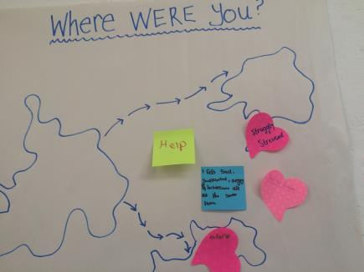
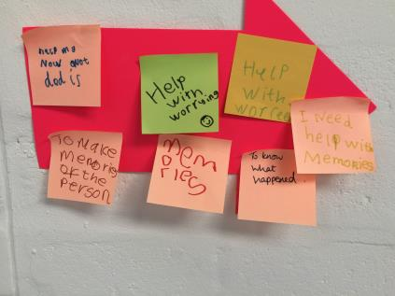
Notes:
Wordens four tasks of mourning are what the small group programme Seasons for Growth is based on.
Worden’s model is meant to be flexible. That means each task of the mourner can be approached at any time, and in no particular order. We know that some mourners will have to complete each “task” several times throughout the course of their life.
Task 1 — To Accept the Reality of a Loss
When faced with a death, especially in the case of a sudden or unexpected loss, it feels unreal. And it can hit us on many levels. For example, we might rationally accept the fact a loved one is no longer with us, but deep down, emotionally, we don’t. Acknowledging the new reality is an important foundation for healing.
So how do mourners complete this task? Rituals often help. Acts such as viewing the body, helping plan the funeral or memorial service, or scattering a loved one’s ashes are all rituals that help move us closer to acceptance.
TASK 2 To process the pain of the loss
This task basically states that a mourner should allow themselves to feel. When we grieve, there’s no telling what emotions we might feel. Grief exists on a large spectrum. There will be sadness, pain, fear, anger, helplessness, guilt and a whole other variety of emotions.
Task 3 — Adjust to the World Without Your Loved One
After a loss, we have to adjust to our “new realities” of life without our loved one. This task requires adjusting externally to the world, but also internally, to new emotional and spiritual needs.
The types of adjustments also vary depending on our relationship with our loved one. For example, someone who has lost a spouse will have extra responsibilities as a caregiver around the house. This requires external adjustments. But a recent widow or widower will also have to adjust to the concept of living alone or doing things by themselves. This requires emotional adjustments.
Worden notes these adjustments are not easy and will take time. But working on this task helps us to better understand our new role in the world, as well as help us realize the impact that the loss has created in our lives.
Task 4 To emotionally relocate the loss while moving on in life
This task means finding a way to remain emotionally connected to our loved ones. This helps reaffirm that our relationship with a loved one didn’t end at death. There are many ways to do this. It could be creating a physical memorial connection, such as a memorial photobook, piece of jewelry, or another keepsake item. Or it could also be a ritual, such as visiting the gravesite or their favourite places at certain time of the year.
The importance of creating this connection is that we can maintain our connection with our loved ones, even as our own lives continue to change.

Slide 16

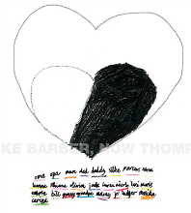
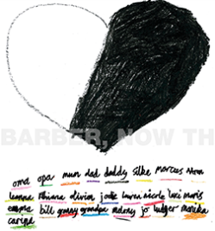
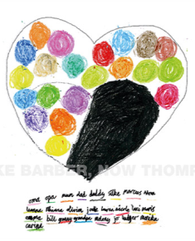
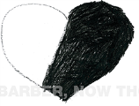
Tonkin’s Theory - Growing around Grief
Image courtesy of CBUK
Notes:
Grief is not linear
Different for everybody.
One person may be in one place and the other in another. Differing stages at different times.
In essence, Tonkin’s model of grief challenges the idea that ‘time heals all wounds’ or that grief disappears with time. Indeed, if you have recently lost a loved one, you might feel as though it is impossible to ever move on from grief. Dr Tonkin suggests that this is because we do not move on from grief, but grow around it.
If you look at the image of the bottle this is demonstrated by the bottle getting bigger rather then the grief reducing.
The bottom pictures represent the drawings of the son of Elke Barber who wrote the book ‘Is Daddy coming back in a minute? ‘ after her husband died suddenly. She asked him to draw his heart and how it was feeling after his Dad’s death – the black part of the heart represents his grief. She then asked him to add in all the people who support him but realised that they wouldn’t fit in one half of his heart so he decided to make his ‘heart’ bigger so they could all fit

Slide 17
Activity – stop and reflect
What have you heard people say to children/young people who are dealing with loss, change and/or bereavement?
What is helpful?
What is unhelpful?
Have a look at his document for some ideas of what could be helpful
Supporting a young person through loss

Slide 18
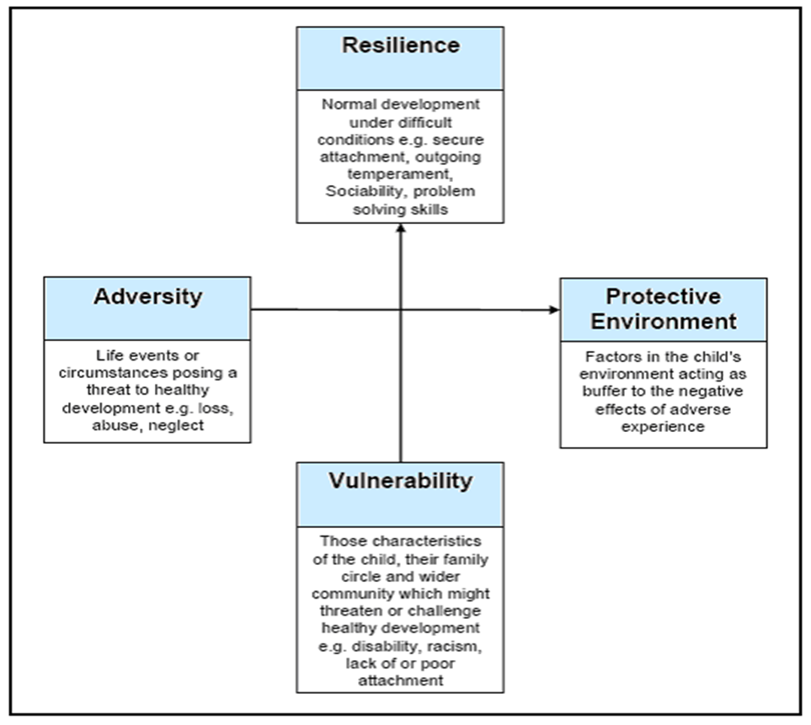
Resilience Matrix
The Five Questions
What is getting in the way of this child’s wellbeing?
Do I have all the information I need to help this child?
What can I do now to help this child?
What can my agency do to help this child?
What additional help, if any, may be needed from other agencies?
Notes:
Always remember to come back to thinking about the resilience matrix and the five questions. These might not be children/young people that you are familiar with. Is there information that would help you to be aware of or should you be sharing information with others.

Slide 19
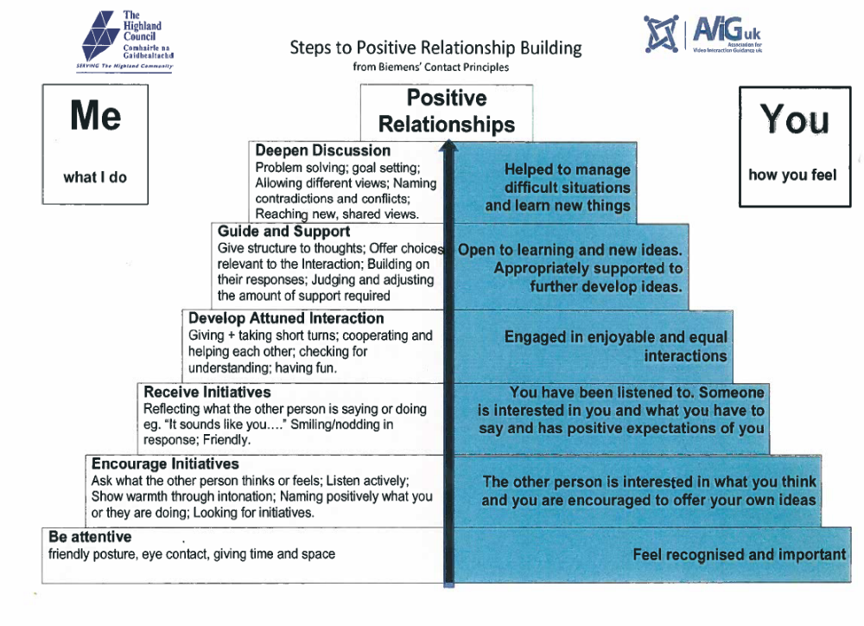
Notes:
This is the positive relationship pyramid and it helps us to think about the steps we need to take to build positive relationships. At the heart of any interaction that we will have with children and young people is relationships. Quite often when we are helping others we want to get to the top of the pyramid where we are helping them to problem solve or set goals. However unless we pay attention to the ‘foundations’ of the pyramid we will struggle to do this. Please remember that being attentive relies on our non verbal communication –whilst we need to socially distance we can still show young people that we are listening to them by giving time and space to sit and listen. Friendly posture and eye contact can be still be offered from a distance!
Listening skills are so important when we need to encourage intitiatives.

Slide 20
Seasons for Growth
Seasons for Growth is based on the belief that change and loss are part of life and grief is a normal response to these losses. Children, young people and adults need the opportunity to learn about how death, separation, divorce or other significant loss events may impact on their lives. The Seasons for Growth programs provide an opportunity for participants to learn the knowledge, skills and attitudes required to understand and respond well to such experiences.
More information is available on the Highland Change, Loss and bereavement page Click here to find out more.
Some of the children that are attending the hubs will have experienced being in a Seasons group. It might be an idea to ask them if they have and is there anything from that experience that could help them just now.

Slide 21
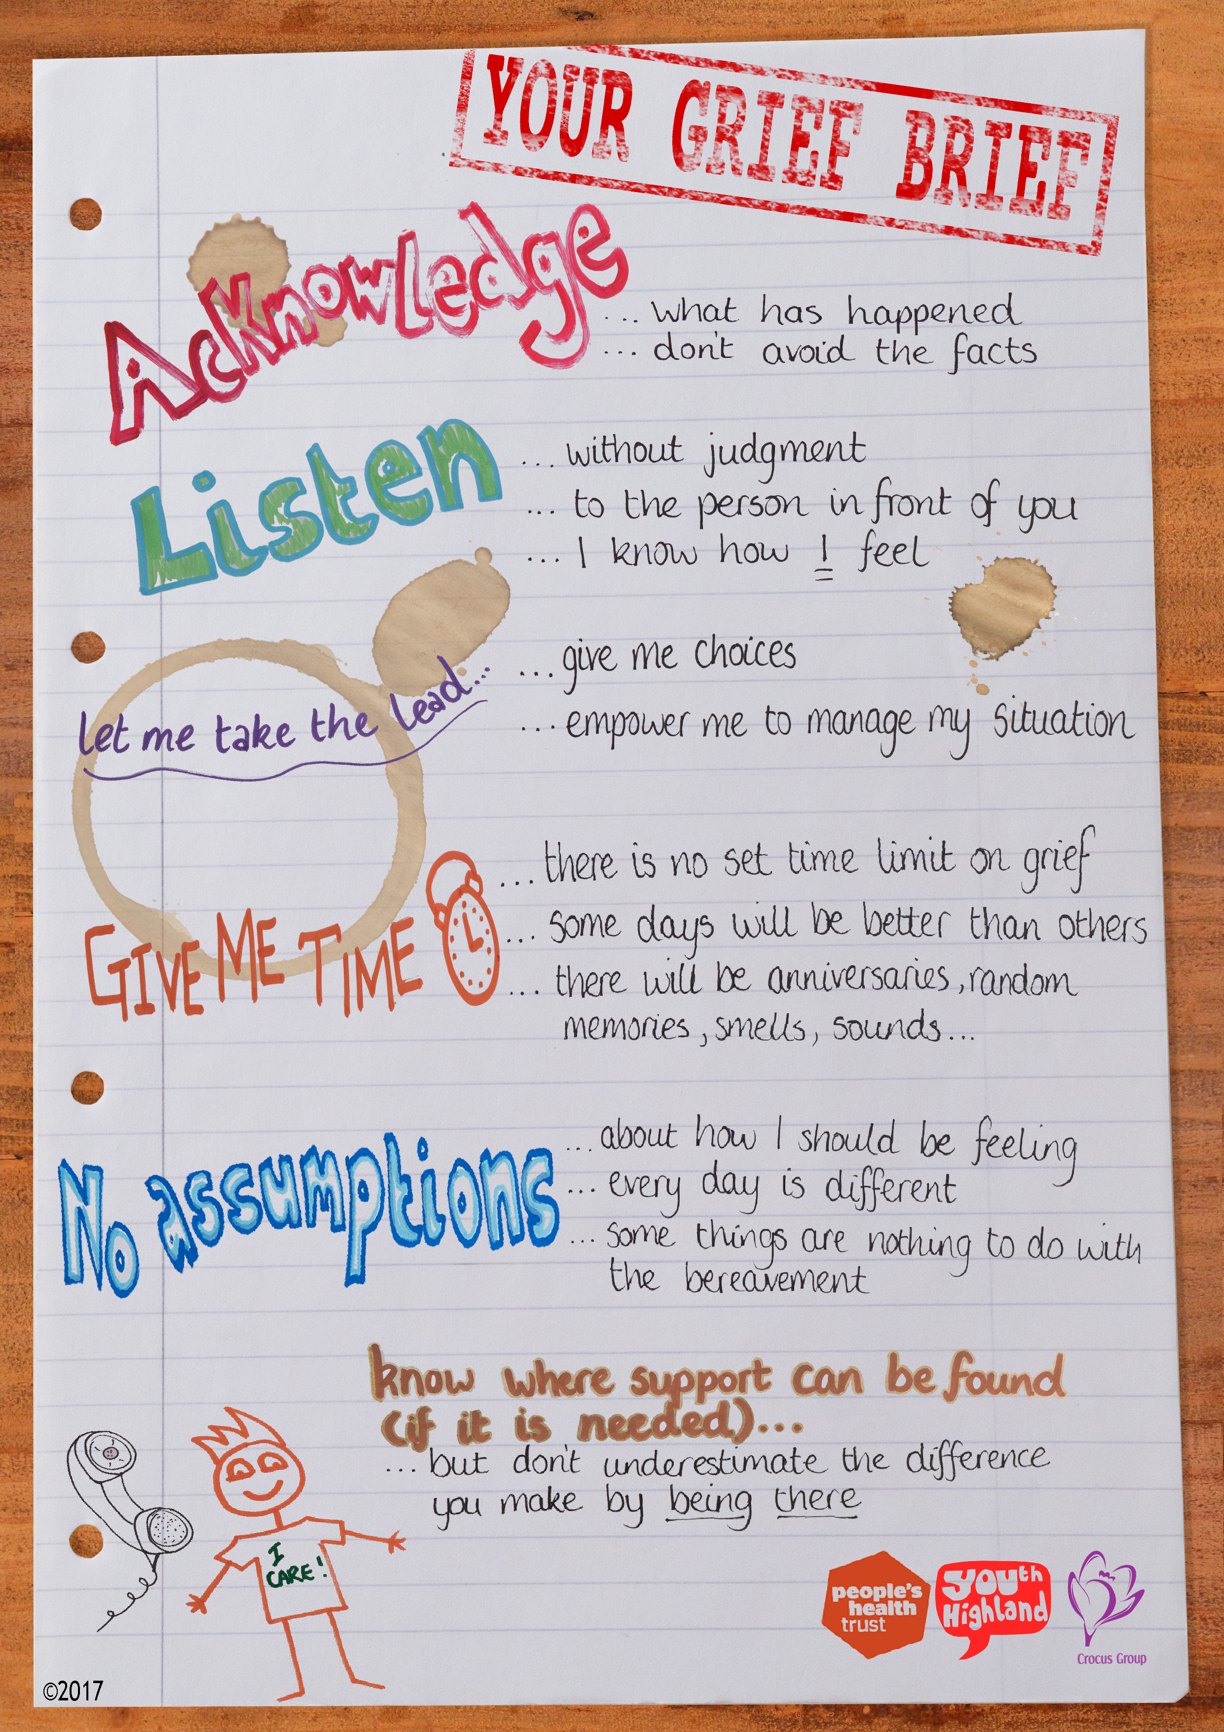
Crocus
Crocus group are a local charity that offer support to children who have been bereaved.
Some of their young people developed this ‘Grief Brief’ – it is their advice to others about how to support them or other young people when they have experienced loss.
Find out more about Crocus here.
Notes:
This is a document that Crocus worked together with

Slide 22
Support
Every Childcare hub will have a link Educational Psychologist and Primary Mental Health Worker. Both services would be able to offer consultation to think about the needs of the child and give advice about how best to support them.
Some other useful resources for support are:
Highland Change, Loss and Bereavement website
Tragic events guidance for schools
CAMHS resources
NHS – Health Scotland
Little Book of Loss
Notes:
Staged intervention – not all about referring on. Discussion/consultation with these staff would support you if no need for referral on.

Slide 23
Mindapples
1.
2.
3.
4.
5.
Notes:
Finally, please come back to your mindapples. It is important that we remember to look after ourselves. Please make sure that you go home today and do something that is self care. You deserve it.

