Slide 1
Quest and Q Skills
The Highland Council
Assessment - Tracking - Monitoring
A brief overview of the background to this approach and basic information on how to start using it.
March 2019

Slide 2
Background
Quest - previously introduced as Routes to Learning (Wales)
Schools creating own schemes not always underpinned by research
Currently there is no Council wide scheme to assess, track and monitor pupils with complex and profound needs.
Mainstream schools trying to meet the needs of one or two pupils with complex or profound needs left very much on their own with no staff discussion or base line established.
Notes:
Elaborated curriculum from 5-14 could no longer be used when CfE was introduced and this did leave a gap for learners who are not yet working within CfE Early Level.

Slide 3
Rationale
‘…for those individuals who consistently fail to show measurable progress on conventional assessments, a different model of progress is required. It is not that these individuals cannot make progress, but we may argue that the instruments by which progress is measured do not suit the people whose abilities are being measured.’
Barber and Goldbart (1998)
Notes:
Rationale (1998) old reference, but still cited by Scottish Government.

Slide 4
Purpose
All pupils should be following Curriculum for Excellence
We need to be able to justify what we are teaching
We need to evidence our work
We need to be able to track and monitor
We need to be linking this to IEPs and Child Plans

Slide 5
Northern Ireland CCEA
The education assessment group in Northern Ireland had created tracking and monitoring systems for every school except Special Schools
They first looked at the Routes to Learning Scheme created by Wales - Wales gave them the materials copyright free
Staff released from schools to create Quest assessment and monitoring and then curricular materials
Realised they needed a bridge between Quest and National Curriculum and created Q Skills
Notes:
Quest and Q Skills was developed in Northern Ireland (NI)
Quest is based on Routes for Learning from Wales which Special Schools in Highland were using a few years ago. Quest for Learning is for children who are developmentally 18mths or earlier, it is the ORANGE FOLDER.
Q Skills (PrereQuisite Skills) is for children who are developmentally between 18mths and CfE Early Level and it is in the GREEN FOLDER.
NI Level 1 is where you would expect typically developing children to be during P1
Q Skills levels 1-5 build up to this level. Once children reach ‘Level1’ in an area they would be assessed through CfE in that area.

Slide 6
Available for Free Download
All of the Quest and Q Skills materials are available as a free download from CCEA
All of the curricular materials created are also free to download
Google ‘Northern Ireland Curriculum’ and then click on SEN
http://ccea.org.uk/curriculum/sen_inclusion
Go to The Highland Council Website ASN pages for further information, resources and documentation
https://www.highland.gov.uk/info/886/schools_-_additional_support_needs/43/pre-school_home_teaching_service
Notes:
Quest and Q Skills are NOT an elaborated curriculum, and this term should be used as it confuses with Elaborated Curriculum (Elaborated Level A) from 5-14 (not in use since the introduction of CfE). They are assessments rather than a curriculum One set of folders will be left in the Culcabock meeting room for reference.
Folders originally sent to North, Skye, Lochaber, Dingwall and Inverness
Although it is an assessment, there are associated teaching materials available in NI and everything can be downloaded for free online (see link in PowerPoint). The teaching materials are in themes and include lots of sensory activities for children with complex needs so they can experience it and then their response and interaction can be observed and recorded.
The working group are pulling together other links and resources to make them available to all teachers in Highland.

Slide 7
Highland Progress
Training took place September 2015 – DVD of Quest training available – copies held by ASN Offices in each area.
Working group rolled out the implementation.
Links made with CfE experiences and outcomes.
Creating resources links to differential CfE activities
SEEMIS link - Teachers keep their own assessments they can add them as a PDF for SEEMIS if they wish
QIO’s totally behind this
Quest and Q Skills pulled down options made available on Primary reports
Notes:
The Quest Map has been linked with Curriculum for Excellence (CfE) Experiences and Outcomes but Q Skills have not been mapped fully onto Experiences and Outcomes. This would be a huge task and may not be useful as Q-Skills is for pre-Early Level. HMIe are pushing for links to CfE to be made.
Q Skills has been linked to Es and Os to show how Health and Wellbeing is embedded across the strands.
Assessments can be added to Seemis by teachers as PDFs.

Slide 8
Next Steps for Highland
2016 Onwards - Schools and Individuals to begin using the materials
January 2017 – 2019 training days ran
2019 resources put on ASN website in Pre-school home teaching service section
Supplementary Resources and links will be available on Psychological Services BLOG
Notes:
Planned next steps include…
Putting supporting curriculum materials on a Word Press website to make them available for teachers
Training for ASN teams, EPs, PSHVTs, AHPs across Highland. QIOs and Principal Teachers are already trained.
Matthew asked about the network days and Barbara did not know if the proposed network days will be central or in local areas. May be discussed on training days to see what suits those in areas. There is a need for a proper launch, Quest and Q-Skills are both available to ASN teams in Highland and used by some but has not promoted.
Heather pointed out that the EP service could potentially have a big influence on introducing and supporting QUEST and Q Skills. EPs having discussions with ASN teachers and others working with child about QUEST/Q Skills may be useful and supportive if child in school.
The working group want everyone to have access to all resources made for learners with ASN to avoid unnecessary duplication. The aim is to gradually build up resources as schools use this and make materials geared from their pupil with complex needs.

Slide 9
Quest & QSkills
CfE, Quest, and Q Skills allow for pupil-centred planning and assessment which puts the needs of learners first. Teachers may include additional elements in the curriculum, as appropriate to learners’ needs.
This holistic approach is appropriate for learners working at the very earliest levels of development, including learners with profound and multiple difficulties (PMLD). The focus is on skills and capabilities, rather than “working towards” subject-related targets that may not be priorities for the individuals concerned.

Slide 10
Strengths of Quest and Q Skills
Equality of provision with pupils with ASN.
Pupil centred planning and specific IEP targets
Accurate reporting to parents
Encourages higher standards of teaching and learning
Clearly shows pupil progress
Identify pupil’s skills, strengths and areas for development

Slide 11
…in addition
Assessment appropriate and meaningful
Provides future direction for teachers
Commonality of language
Qualitative data rather than quantitative

Slide 12
Principles of Assessment
The principles of assessment achieve coherence across experiences and outcomes, learning and teaching and assessment practice:
  Supporting learning
  Ensuring learner engagement
  Identifying progress, including lateral progression
  Ensure consistency of reporting
  Ensuring appropriately targeted support for pupils

Slide 13
Assessment Continuum
Quest (PMLD)
Q Skills (Q = pre-reQuisite)
Tracking progression prior to Early Level of CfE
It is important to remember that Quest and Q Skills are not a replacement for the curriculum, the curriculum is CfE.

Slide 14
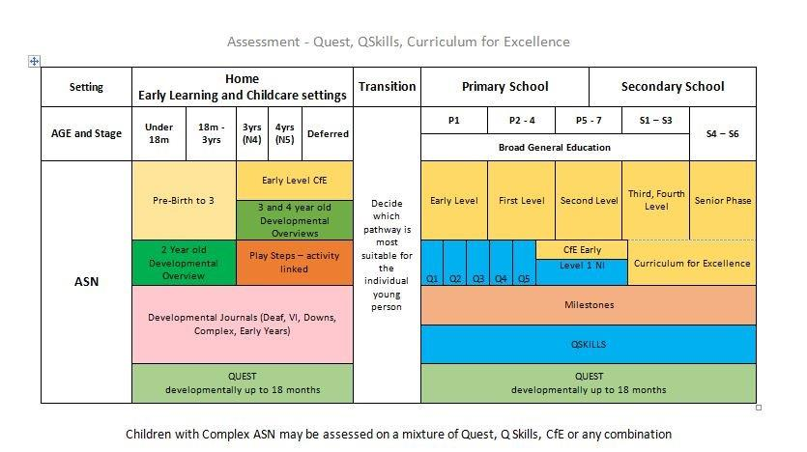
How does it all fit together?
Notes:
This is a visual to show how QUEST, Q Skills and CfE all fit together, as well as the Developmental Overviews and Play Steps (which was developed by the PSHVT team) and the Developmental Journals. Developmental Journals are also being used by the sensory teams as well as PSHVTs.
Also, for reference, 3-4yrs in nursery are N4 and 4-5yrs in nursery (pre-school) N5 on Seemis, which has confused professionals and schools. Deferred nursery pupils are also N5.

Slide 15
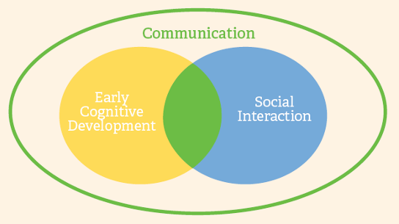
Quest
Quest focuses on key learning priorities:
  early cognitive development
  social interaction
Communication underpins and is integral to both key learning priorities
Developmental equivalent: 0 – 18 months
Notes:
Very important for Speech and Language Therapy to be involved as early communication is key to Quest assessment in particular.
Videoing the children will capture signs of communication, although there may be disagreement between professionals about the signs of communication. This has been found in practice.
DVDs are included with some packs but they contain footage of NI children so it was felt that there was not permission for use. Routes to Learning video clips are available.
Highland may, over time, make their own videos and leaflets without NI references and links to NI curriculum.

Slide 16
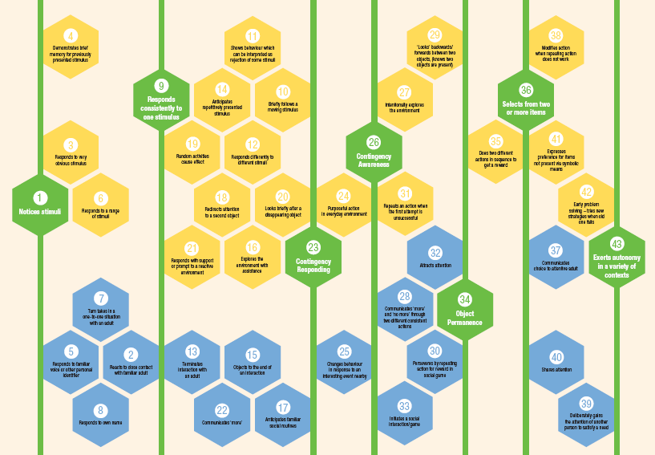
Quest Map
Notes:
Networking will be important to discuss best ways of recording information, e.g. pupil and staff targets within each Quest statement. This is still being worked out and tried out. Recording needs to be shared as different professionals may be doing it different ways.
Barbara described an example of a boy with complex ASN where Barbara and Izzy worked together using Quest to assess a pupil and inform planning.
Seven Key milestones (green on Quest Map), where is child, has child reached these milestones, gives a baseline assessment. Those who know the child look for evidence that the child has reached level on Quest map. Milestones (yellow and blue) between the Key Milestones are referred to for assessing level and planning to take forward. Key milestones could be used as IEP targets.
Children do not need to reach every yellow and blue milestone or follow a specific pathway. Very individual.
Best way to learn is to use the maps. It’s the discussion process which is key.

Slide 17
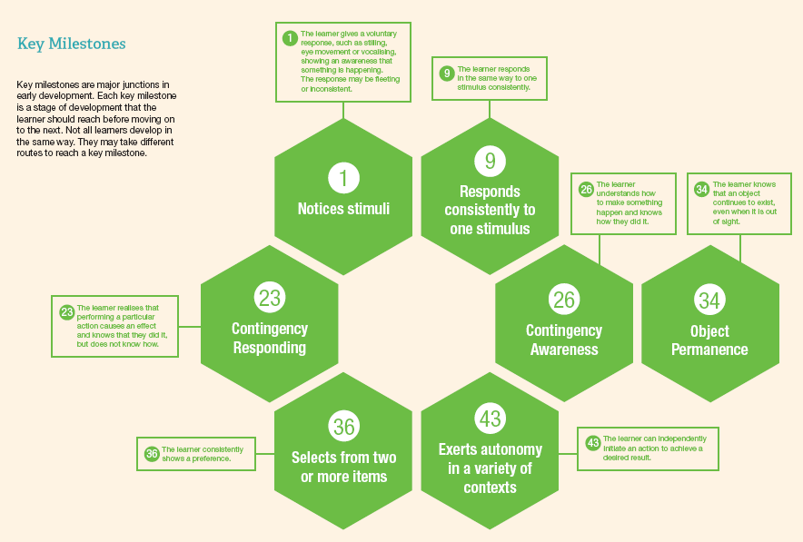
Key Milestones
Notes:
An editable Quest Map, Progress Recording sheets and templates are available to record progress.

Slide 18
Using QUEST
Make sure you are familiar with the seven key milestones (green)
Focus on a learner and identify a key milestone
Check which is the next milestone. If beyond learner’s ability assume learner is working between two key milestones
Refer to the milestones in between key milestones and select starting point
Set up appropriate assessment activities
Notes:
Using QUEST in nursery may be appropriate with children with really complex ASN but using Q Skills at nursery was discouraged as other assessment materials are available and it is just too huge. It could be introduced at nursery to primary transition to familiarise staff and parents with what will be used.

Slide 19
Milestones
Learners do not need to visit every milestone or visit milestones in sequence
Many different and individual pathways are possible
Key milestones could be used as IEP targets with link to Quest
Please note this refers to Quest milestones not the Scottish Government milestones produced for the curriculum. The Quest milestones cover the first 18months of a child’s development.

Slide 20
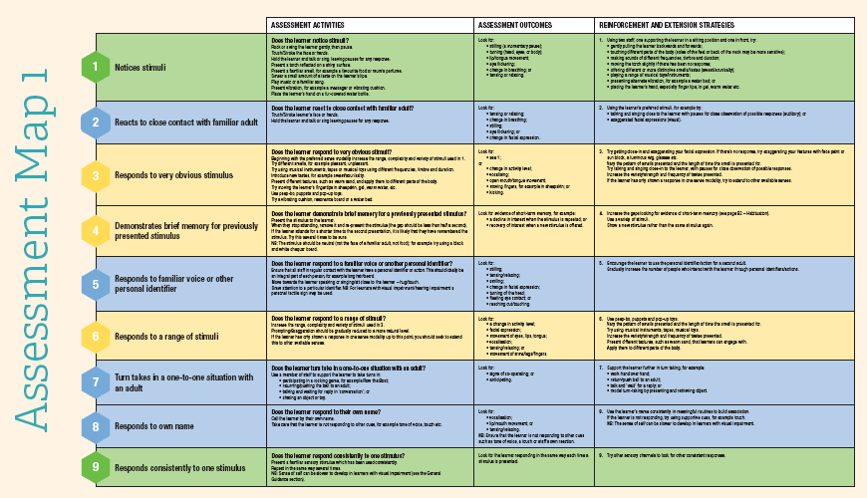
Quest – Assessment Maps
Notes:
Examples available to explore each target. Video clip examples are available through Routes for Learning.

Slide 21
Collaborative Process
Record observations – VIDEO can be helpful for promoting discussion and agreement.
Involve parents in discussions
Team around the Child – include their knowledge
Review observations together
There may be differences of opinion on observations this is fine, it means you need to explore further

Slide 22
Key Milestones
Example
Notes:
For example
Child age 20 months. Rare syndrome. None Verbal, not yet mobile.
No SLT at the moment so looked at this with parents generally for ideas.
Best practice group around the child.
Use video, review as a group. Share observations.
34 - We know he has object permanence as he is at that stage where he throws things down for his parents to retrieve. Also looks towards an object you removed from sight.
36 - Selects from two or more items.
He can do this with two sound making objects and will reach out for one. He was doing this mostly with his right hand so we tried moving the preferred object to a different side. He reached across his midline to grasp the preferred object.
Next step is to extend the variety of objects and situations
43 – we don’t feel this has been achieved yet so we are also looking at areas in between, particularly 40 – sharing attention.
Helps to ensure learning is developmentally appropriate

Slide 23
Q Skills
The Prerequisite Skills, or more commonly known as Q Skills, are an assessment resource to support teachers and pupil support assistants. The skills described in the resource, build towards Early Level in Curriculum for Excellence.
The Q Skills provide a broad and inclusive framework for assessing learners, taking into account age, cognitive ability, learning difficulties and other significant complex needs.
Notes:
The colours on the Q Skills paperwork and other documents are linked to the NI curriculum and help you separate them but documents also available in black and white. Different sheets are available for different types of recording. These may look different for Highland by the time training in delivered in Jan-Mar 2017. (Louise mentioned that there are further budget cuts to be made by teams so printing and copying may have to be reduced.) The documents have to printed on A3 (cannot be printed on A4 and blown up as the text will not be clear) and you could print double-sided and in black and white.
Based on Child-centred principles, the pathway can be different for different children depending on their learning needs and how they engage with what they are experiencing. A child’s IEP may include a mixture of targets from Q-Skills and CfE, for example. Children may progress through the milestones or may stay at a specific level for a long time, so the emphasis would then be on breadth within that level and gradually decreasing support to encourage more independence.
Including parents in assessment and planning process is important as they notice things that education staff have not and vice versa. In Heather’s experience, being involved in the assessment process helped parents understand that showing independence in a skill was vital for moving on and it defused a huge issue when parents see their child managing a skill with support or parroting without understanding and thought that their child was accomplished in that skill.

Slide 24
Q Skills Levels
The requirements outlined in the Q Skills for Communication, Using Mathematics and Using ICT align with the mainstream Curriculum for Excellence Early Level and are broken down into five skill areas.
Within each of the skill areas learners' progress can be demonstrated by moving through the Q Skills as well as decreasing levels of supports from adults within a skill. These are explained in slides 28-32.
Having different levels within each skill allows pupils to progress at a level but also gives options for pupils with deteriorating skills to still show progress in skill maintenance.

Slide 25
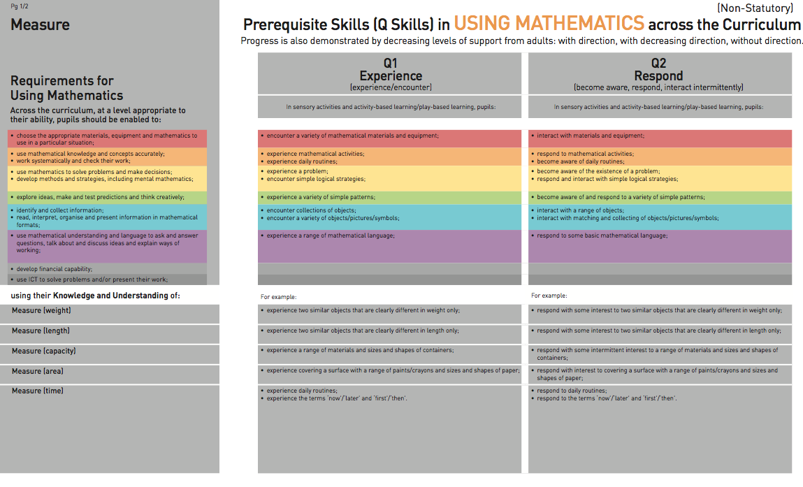
Brief explanation of layout – using Mathematics

Slide 26
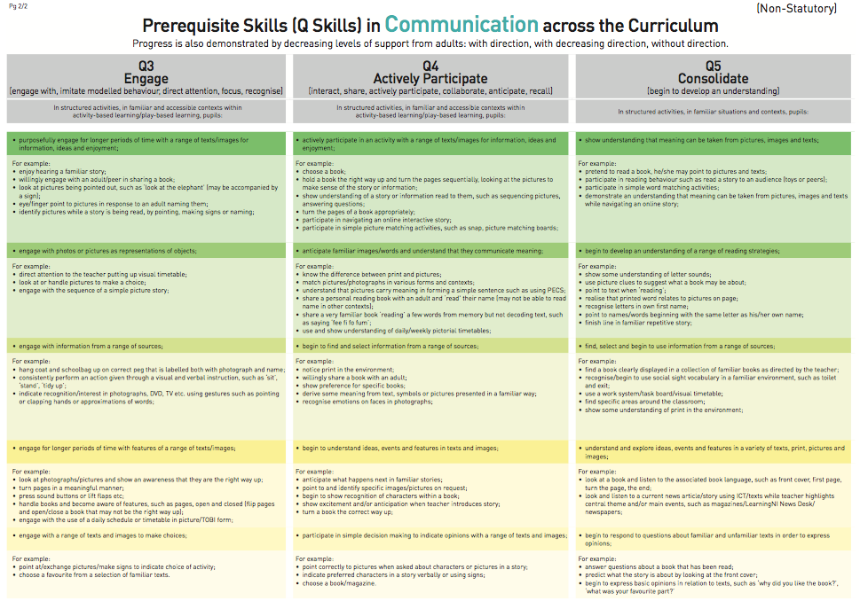
Communication

Slide 27
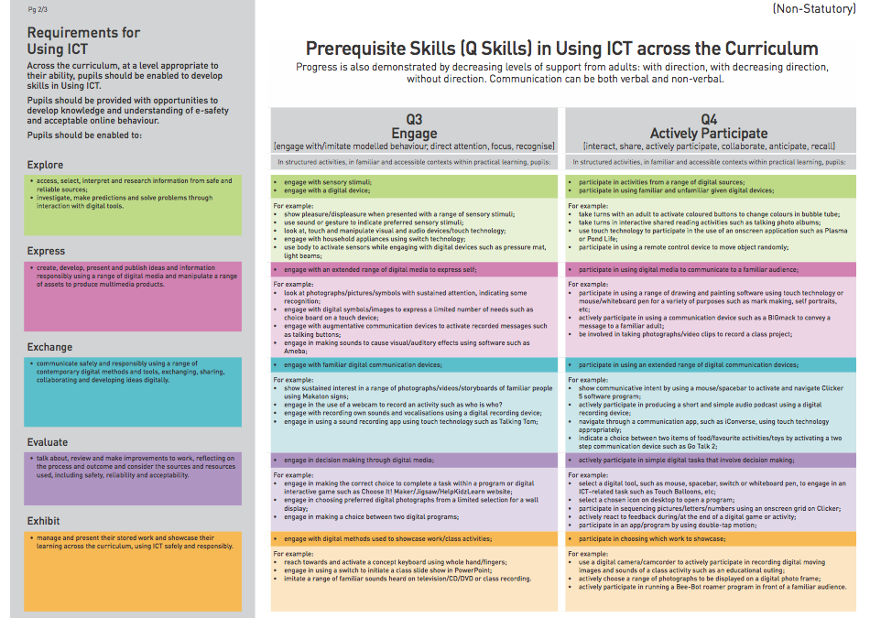
Using ICT

Slide 28
Q1 Experience/Encounter
A pupil is present during an activity but shows minimal response.
In each skill area there is a list of statements about what pupils may do in specific types of learning activity.

Slide 29
Q2 Respond
The pupil shows signs of enjoyment, surprise, frustration or dissatisfaction.

Slide 30
Q3 Engage
The pupil shows interest, enthusiasm, communicated through body language, focused looking, or listening, and redirects attention when the activity ends

Slide 31
Q4 Actively Participate
The pupil shares, takes turns and anticipates familiar events.

Slide 32
Q5 Consolidate
The pupil combines learning and generalises skills, knowledge, concepts and understanding, relating to curricular experiences.

Slide 33
Level 1
This is the final progression level for each skill.
It is a Northern Ireland term for the first level of their curriculum .
The working group compared this level to CfE and it broadly corresponds to the starting point to CfE Early Level.

Slide 34
Links to CfE
Quest has been linked to Experiences and Outcomes
Q Skills - Levels Q1 to Q5 work towards Early Level CfE
Health and Wellbeing is embedded within the range of Q Skills strands
Visuals have been created to support the HWB Early level Es and Os

Slide 35
Editable recording sheets
Slides 36-38 show examples of recording sheets
Copies can be found on the ASN website
https://www.highland.gov.uk/downloads/file/20563/quest_recording_sheets
https://www.highland.gov.uk/downloads/file/20599/q_skills_observation_sheets_editable

Slide 36
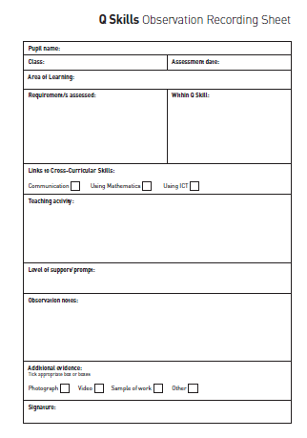
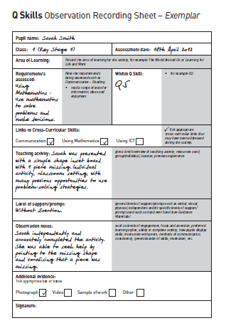
Recording Sheets - Examples

Slide 37
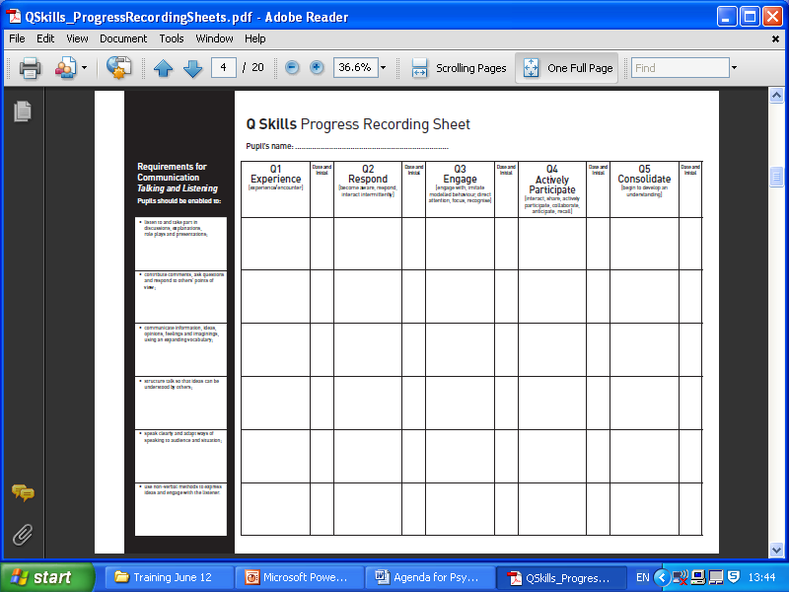
Recording Sheets - Examples

Slide 38
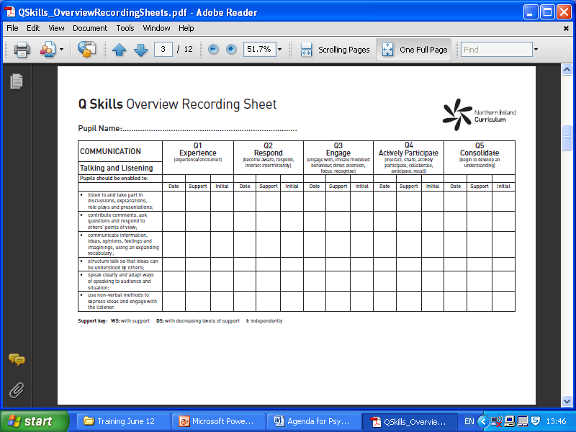
Recording Sheets - Examples

Slide 39
Thematic Units
Northern Ireland has created free to download thematic units with differentiated ideas for including pupils with PMLD into class topics or projects.
They cover a range of ideas commonly studied in schools

Slide 40


Thematic units
A Pirate’s Life for Me
Our Academy for Witches and Wizards
Autumn
Perfect Picnic Fun
Let’s All Go on a Summer Holiday
Around the World to Australia
The Circus is in Town
The Victorians
A Magic Carpet Ride
Stepping Back in Time
To Infinity & Beyond

Slide 41
Resources
All resources developed and collated to support Quest and Q Skills can be found at the following links.
ASN Website: https://www.highland.gov.uk/info/886/schools_-_additional_support_needs/43/pre-school_home_teaching_service
BLOG: https://highlandcouncilpsychologicalservice.wordpress.com/quest-and-q-skills/

Slide 42
Life Skills resources
Free to download from the Northern Ireland website are videos and PowerPoints to use with young people to help to develop and practice life skills.
http://ccea.org.uk/curriculum/sen_inclusion/curriculum_resources/learning_life_and_work

Slide 43
Final statement
Highland is committed to the use of these assessments and support resources for children with ASN.
Please discuss with you area ASN Manager or ASN Officer should you have any questions.

